Slide 1
Maximizing Your Clearinghouse Services
Julie Esau, Regional Director
Joe Roof, Regional Director

Slide 2
AGENDA
Clearinghouse Background
Enrollment Reporting
Reverse Transfer
Transcript Services and Secure Print
StudentTracker Premium

Slide 3
The Clearinghouse Mission
We serve the education community by facilitating the exchange and understanding of student enrollment, performance, and related information.

Slide 4
OUR REACH - ENROLLMENT
3,600
colleges and universities participate with the Clearinghouse
98%
93%
Title IV degree-granting institutions representing 98% of U.S. postsecondary education enrollments participate in the Clearinghouse
Participating postsecondary institutions representing 92% of all degrees awarded in the U.S.
1.1 MILLION
700 MILLION
4.5 MILLION
enrollment verifications
student record verifications
degree verifications

Slide 5




Clearinghouse Services
Enrollment
Reporting
Audit Resource
Center
EnrollmentVerify
DegreeVerify
Student
Self-Service
StudentTracker
StudentTracker Premium
Research Center
Transcript Services
Ellucian eTranscripts
& S.I.S. Integration
Electronic Transcript
Exchange
Reverse Transfer
Notes:
The Clearinghouse currently supports the 4 listed service areas and makes available all of the associated services. I will now provide a very brief overview of each of the services.
<click>

Slide 6

The World of Financial Aid Before the Clearinghouse
Students and institutions suffered

Slide 7


The World of Financial Aid Before the Clearinghouse
GUARANTOR
GUARANTOR
Issues:
Paper-Driven
Expensive
False Positives
Delinquencies
Defaults
COLLEGES &
UNIVERSITIES
NSLDS
STUDENTS
SERVICER
SERVICER
Notes:
This slide illustrates the enrollment reporting process for an institution, prior to the National Student Clearinghouse. Reporting was primarily paper based – green bar paper. Everyone suffered including institutions, students and loan servicers.
Animation notes:
Inquiries to the school
Inquiries to the students
Responses from the school and students
Communications between all parties
Result: a big mess

Slide 8

The World of Financial Aid After the Clearinghouse
COLLEGES &
UNIVERSITIES
3,600+ postsecondary institutions
Represents 98% of U.S. enrollment
98%
NSLDS
GUARANTORS
GUARANTORS
SERVICERS
SERVICERS

Slide 9
Enrollment Reporting with the Clearinghouse
Speed
Accuracy
Support

Slide 10

Speed
Faster and more timely
ALL students reported. NSC process determines recipients, including private loan servicers
Identifies and adds 5 million students annually missing from NSLDS inquiry
Outsourced deferment form processing
In-house compliance and enrollment reporting experts to support your institution through every stage of the process

Slide 11

Accuracy
Reduced errors
Data pre-checked to identify and resolve potential issues BEFORE submission to NSLDS.
  Pre-check identifies an average
  26 errors per 1,000 records on enrollment files submitted to NSC that would otherwise have resulted in NSLDS errors
Improved accuracy enhances
the trust and confidence
of the institution

Slide 12

Support
Enrollment management, risk mitigation and education
  Ongoing enhancements keep schools in compliance with evolving guidance and regulations
  Reduces need for schools to maintain technical and business resources to adapt to these changes
  Resources for best practices and audit support
  Online, live, in-person and self-paced training and tutorials
  FSA information regarding trends, focus and upcoming changes is proactively shared

Slide 13
Audit Resource Center
Assists ~1,000 schools per year
Works with you and your auditors to explain issues and provide documentation to reduce and eliminate audit findings
Aids with audits and day-to-day compliance questions
Offers online resources for preparing and responding to an audit
Shares trends in auditor areas of focus

Slide 14
Recent Enhancements for Enrollment Reporting
Sending stacked records to NSLDS
Suppressing L statuses for Non-Comp/Non-Summer
Include checks on Program Length and Title IV Weeks
Five point program level matching for enrollment files
Downloadable reports related to Student Program Level data and other key elements
Additional features and functionality related to editable G from DegreeVerify
NSC is working to meet school client needs expressed and upcoming changes from FSA.

Slide 15
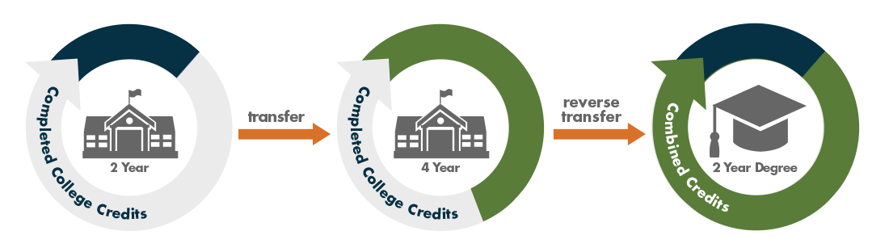
What is Reverse Transfer?
It is the transfer of credits from a four-year (or two-year) institution to any two-year institution from which a student transferred. If eligible, the student is awarded an associate degree.
Notes:
What is Reverse Transfer? A student starts at a community college transfers to a university WITHOUT a degree. Your taking the credits the student is earning at the university and sending them back to the community college to evaluate for a degree. Sounds Simple but it can be complicated.

Slide 16

Potential for:
Increased
Funding
Completion
Rates
A-1
Enrollment
Decrease Student Loan Default Rates
Notes:
What if I could give you a solution that has the potential for
Increasing your funding
Increased Completion Rates
Increased Enrollment
Help in Lowering Default rates
And even better you are awarding degrees to students who have earned it.
That is Reverse Transfer

Slide 17

How do we know it increases completion rates?
66% of students transfer
before
earning an associate’s degree
Notes:
Don’t we owe to these students to help them get their degree?

Slide 18
Increase your graduates!
“Credit When It’s Due (Reverse Transfer) evidence shows a 5% to 18% retention in bachelor’s degree advantage for students who receive Reverse Transfer”
Jason Taylor, Assistant Professor
University of Utah, CWID researcher
18
Notes:
The research shows just like students who transfer with an associate degree that getting the degree through reverse transfer increases the likelihood of getting a bachelors degree. So both Universities and Community Colleges Win by increasing their graduates.

Slide 19
Why is Reverse Transfer Important?
Targets student population with highest student loan
default rates
Notes:
40-50% of the students who transfer without a degree never complete a degree so they walk away with nothing but debt.

Slide 20
Why is Reverse Transfer Important?
Less Student Debt, Higher Default Rates
Students with less student debt are least likely to pay back their loans, because many do not have jobs that pay well.
      $1,000 to $5,000 34%
      $5,000 to $10,000 29%
      $10,000 to $25,000 24%
      $25,000 to $50,000 21%
      $50,000 to $100,000 21%
      more than $100,000 18%
Among graduate and undergraduate borrowers who left school in 2009, share who defaulted by 2014.
Sources: Federal Reserve Bank of New York Consumer Credit Panel and Equifax (Published in TheUpshot, NYT, August 31, 2015)
Notes:
The students with the lowest amount of debt have the highest default rates. The early transfers who stop out have difficulty getting high paying jobs because they only have a high school diploma. Most employers do not look at some college as a benefit. These students are less likely to be able to pay back their loans due to not being able to get a high paying job. If for no other reason this is a BIG reason to participate in reverse transfer.

Slide 21
MOST important reason
Students receive
credentials they have earned!
Notes:
Students work hard to go to college and earn their degrees, reverse transfer is the right thing to do for the student.

Slide 22

The ONLY national solution to provide the ability to exchange course and grade data for awarding degrees.
Supporting your student success initiatives by helping to increase both associate and bachelor degree attainment
Alleviating the workload for community colleges and universities in the reverse transfer process.
Notes:
The Clearinghouse is known for providing support to initiatives that the education community request and needs. Reverse Transfer is one of those new services that the registrar community came together and said it makes sense for this to be national and the Clearinghouse is the place to do it.

Slide 23

Why A National Solution?
Most students are mobile
  54% of enrollments (transfer ins and outs) at a typical institution, on average, are mobile at any given time
Successful students are more mobile
Transfer patterns are complex
  ¼ of all transfers move between states
Reverse transfer can make the difference
Notes:
Students transfer multiple times and move all over our country, The Clearinghouse has the capability to cross public, private and state lines to help students get their degrees.

Slide 24
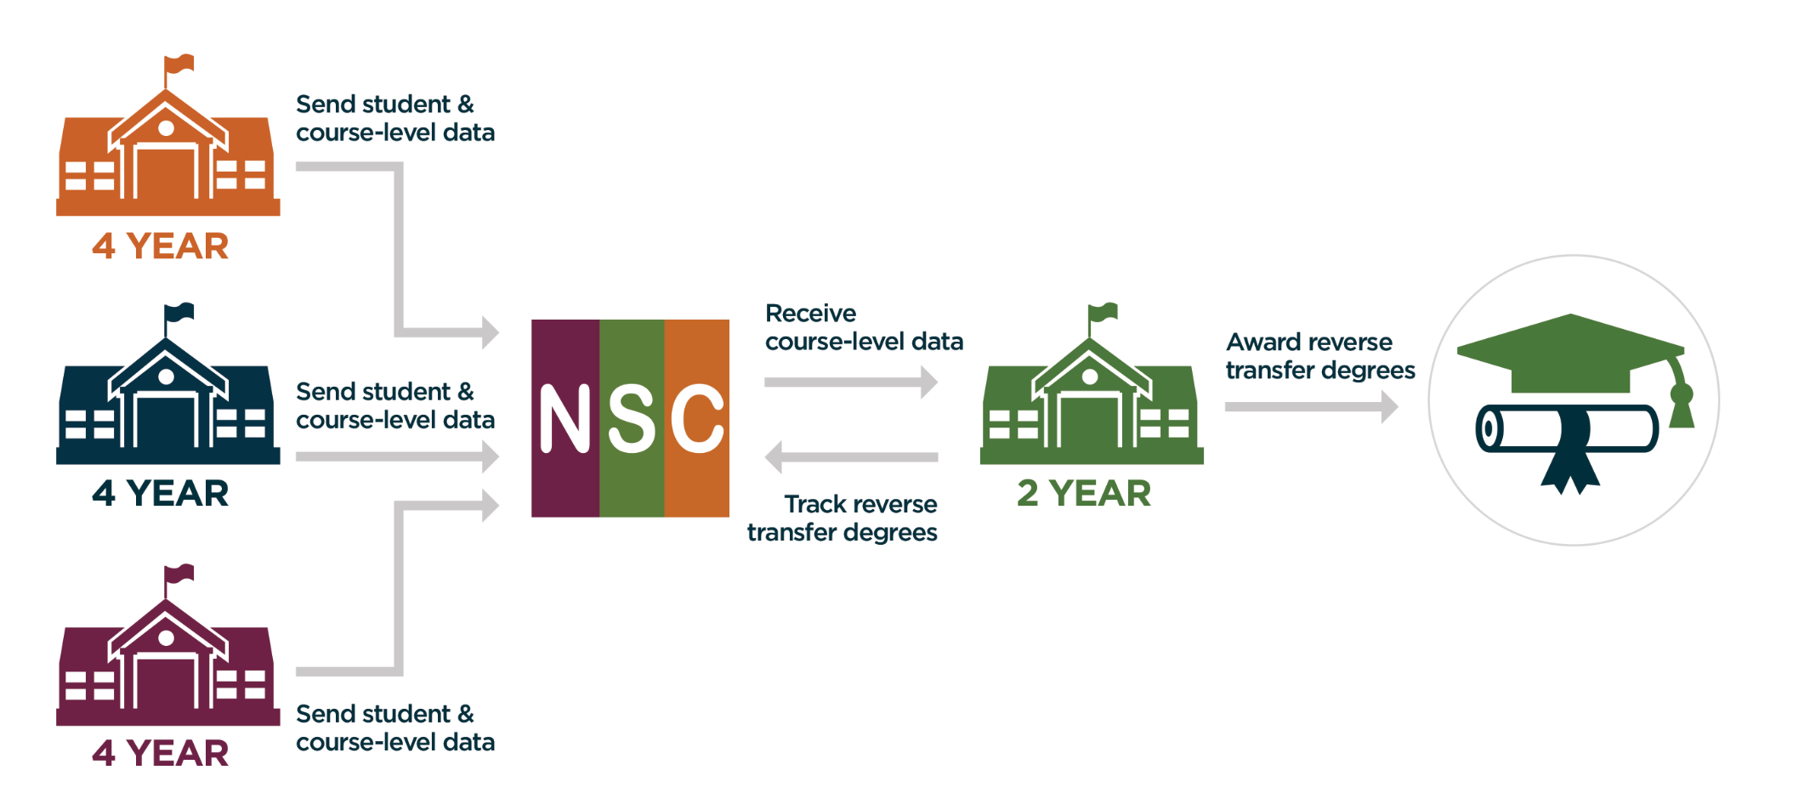
How does Reverse Transfer work?
24
Notes:
How does it work? This is a course grade data exchange, not transcripts. Typically the four year institution gets the FERPA release from the students, then sends one file of all students to the Clearinghouse. We then take that data and send out to all the different community colleges the students have transferred from all over the country. To give an example UT Austin, Texas is mandated by law for reverse transfer, sends us all their students each semester. This past year when new community colleges signed on board in Pennsylvania and Wisconsin they had students already to evaluate.

Slide 25
What can the Clearinghouse’s
Reverse Transfer do for you?
Alleviate the workload by filtering for associate degrees
Process the students on your timeline by downloading cumulative student data when you are ready to evaluate for the semester
Easily access the student’s information when they call to ask, when can I get my degree?
NO shuffling through different types of transcripts trying to figure out is the student is physically transferring to your institution or is it a reverse transfer student.
Your trusted and secure place for all the reverse transfer students data
Notes:
What are the benefits of using our service to community colleges?
BULLET 1: For those of you who work closely with transfer students you know they request their transcripts to be sent to the university right when grades are posted and do not wait till their degree is posted. In sending students back to the community college for reverse transfer many universities send students who already have a degree. We have that data and alleviate the workload on the community college by filtering for associate degrees.
BULLET 2: When the files come in you can look to see what the work load will be and determine in the semester when you want to process the students and then graduate them in your normal processes at the end of the semester
BULLET 3: Student call and asks if you have their information for reverse transfer just log in and there it is.
BULLET 4: No shuffling through the different types of transcripts to find out if you have received the student for reverse transfer. Log in and you know immediately, and see the students course work.
BULLET 4: you know this one

Slide 26
What can the Clearinghouse’s
Reverse Transfer do for you?
Help you increase your transfer student retention and graduates
Opportunity to offer Reverse Transfer to ALL your transfer students no matter where they transferred from across the nation
One file submission of course grade data from sending institution
No need to send transcripts throughout the semester
Notes:
Bullet 1: The research has shown students who get an associate degree are more likely to get a bachelors degree.
Bullet 2: We have the ability to cross public, private and state lines, no one else has that capability. Think about our military students who typically move all over the country taking classes form 4-6 different institutions
Bullet 3: The Host/University submits one file each semester not multiple transcripts
Bullet 4: This one can be read.

Slide 27

Become Part of the
National Solution Today!

Slide 28
Transcript Services
Your Trusted Source for Postsecondary Transcript Services

Slide 29


It is our goal to provide you relief from administrative burdens and costs related to the ordering and fulfillment of transcripts by easing the process and continuing to align ourselves with Strategic Partners such as Ellucian
With nearly 1,000 schools participating in Transcript Services, we strive to continue to make your transcript process easy by providing FAST, FASTER, and FASTEST service

Slide 30
Integration Options
eTranscripts with Ellucian integration
PeopleSoft/Campus Solutions Integration
API integration for any SIS

Slide 31
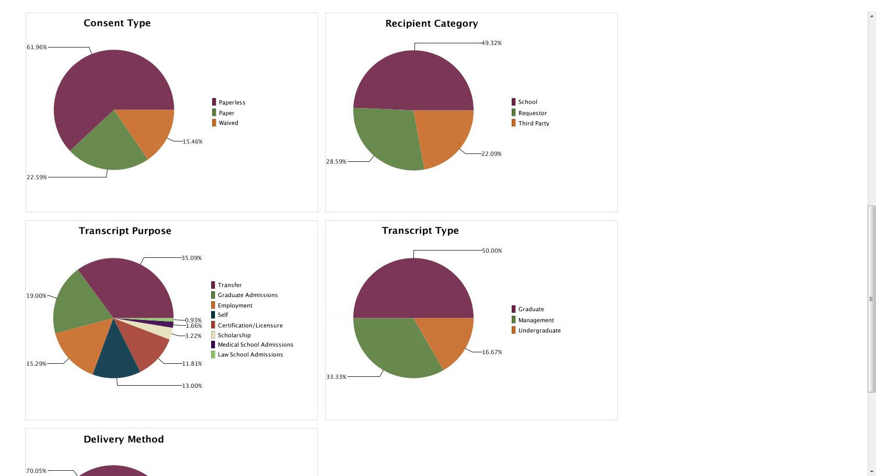

Slide 32

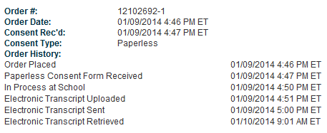

Transcript Delivered In Minutes
14 minutes:
Order placed,
consent form complete, and PDF ready to be securely picked up!
Electronic Transcripts sent out of network are available for download up to 30 days. Transcripts through ETX will be available for 180 days. After the expiration period is reached in both cases, the Clearinghouse permanently removes the transcript from our servers.
Notes:
Order Delivery: Transcripts Delivered in Minutes
eTranscript Solution will receive the order information from the Clearinghouse Transcript Ordering and produce and deliver an electronic transcript completely touch free in as little as 15 minutes. Here is an example of a real order. The order was placed at 4:46 in the afternoon, one minute later the consent form was received, 3 minutes later the order was sent to the Ellucian SIS, and in one minute after that the solution created an electronic transcript and sent it back to the Clearinghouse where it was available for download 9 minutes later.

Slide 33
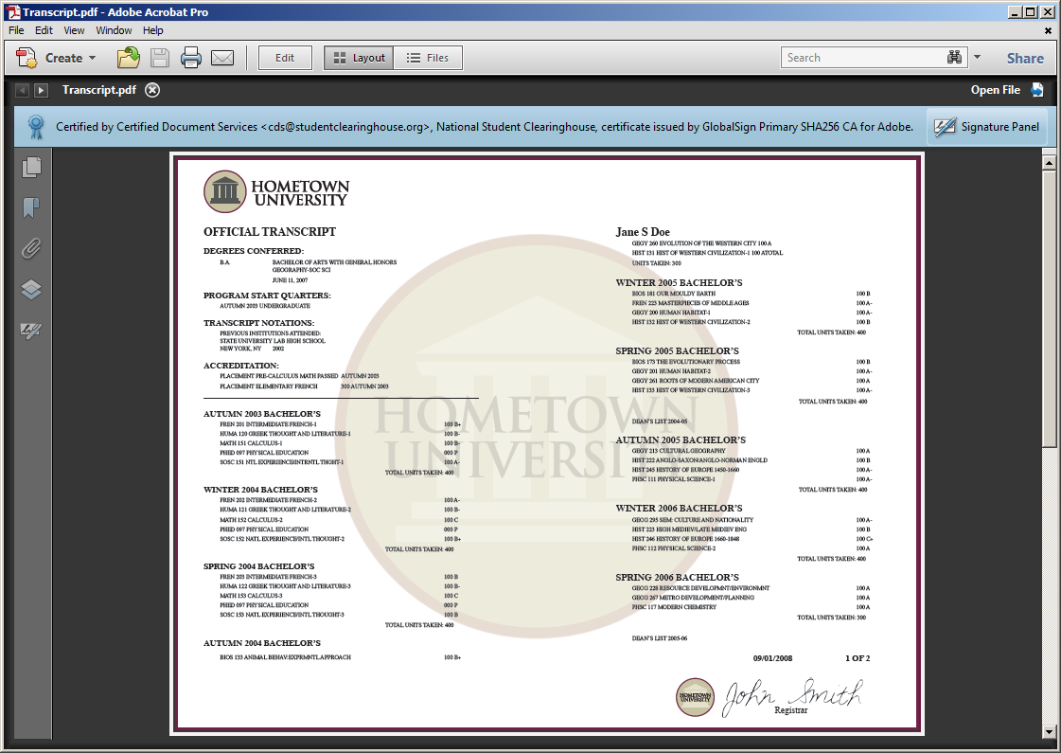
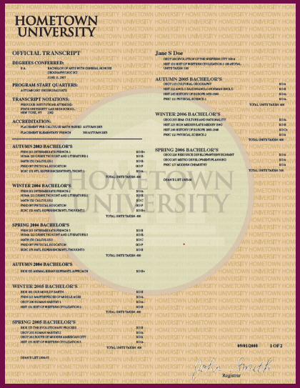
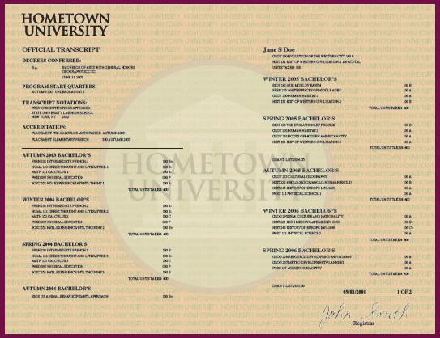
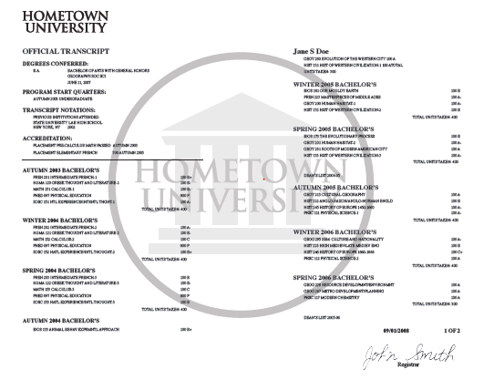
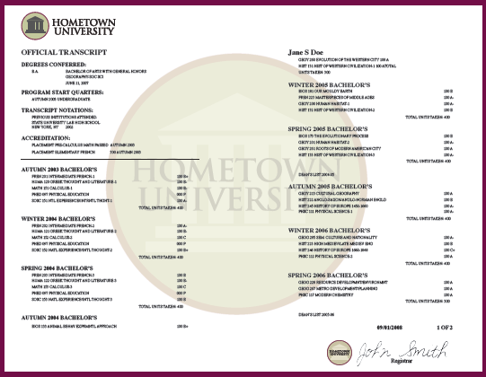
HOLD FOR
BLUE RIBBON PDF Customized PDF Options
Brand ‘Blue Ribbon with your school name
Customized PDF transcript to look like your paper

Slide 34
Transcript Services Redesign
Major enhancement is the website is now mobile responsive resulting in availability on desktop, tablets and MOBILE.
Goal is to decrease number of fields and keystrokes so total processing time is cut 50%.
New student ordering experiences was shown at ACCRAO and Ellucian Live garnering positive comments and requests for participation in MVP.
Scheduled for testing in July, 2018. General Availability is scheduled for the fall of this year.

Slide 35
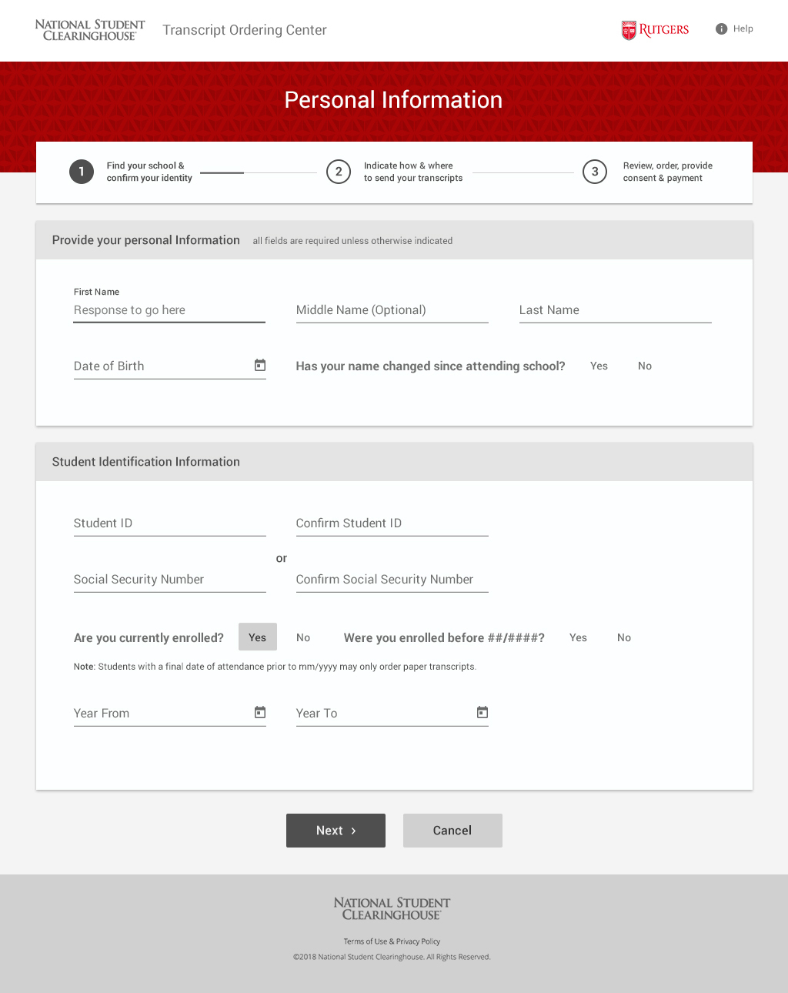
Personal Information

Slide 36
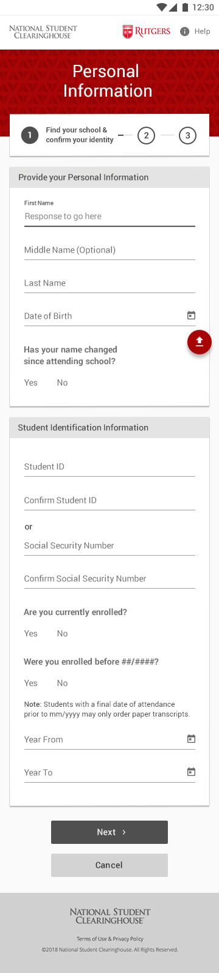
Personal Information

Slide 37
Key Differentiators
Transcript Services is provided at no cost to your institution
  No minimum usage fees, implementation fees or maintenance fees
Gold standard digital security and document control
Secure level 2 PCI compliant delivery of transcripts
FISMA, SOC2, and PCI compliant print facility that prints, inserts, and mails transcripts
Touch-free transcript delivery
Non Profit Status

Slide 38

NSC SecurePrint is…

Slide 39

Flexible
Monday through Saturday production and mailing
Standard First Class Mail and Express shipping

Slide 40
Configurable
Branded with your seal and logo
Customizable cover letter
Include your transcript legend and attachments
Portrait or landscape layout
Black and white or color printing

Slide 41
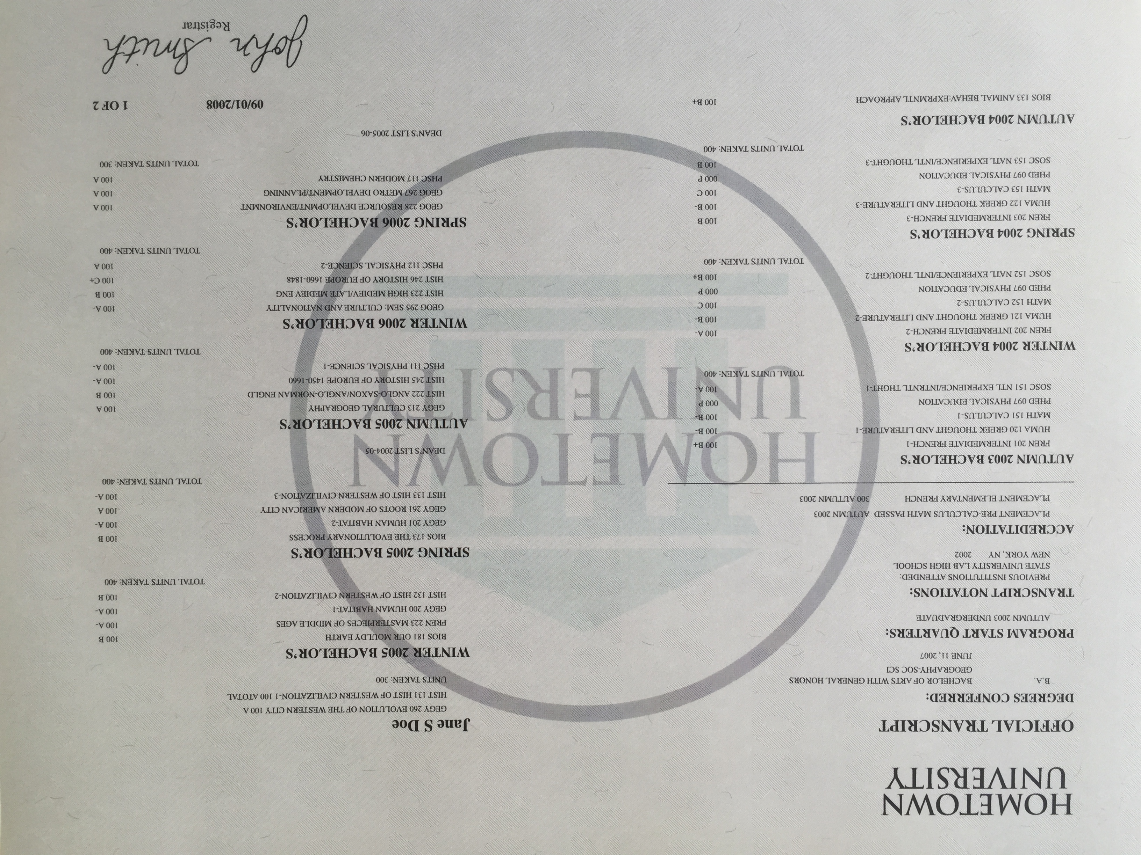
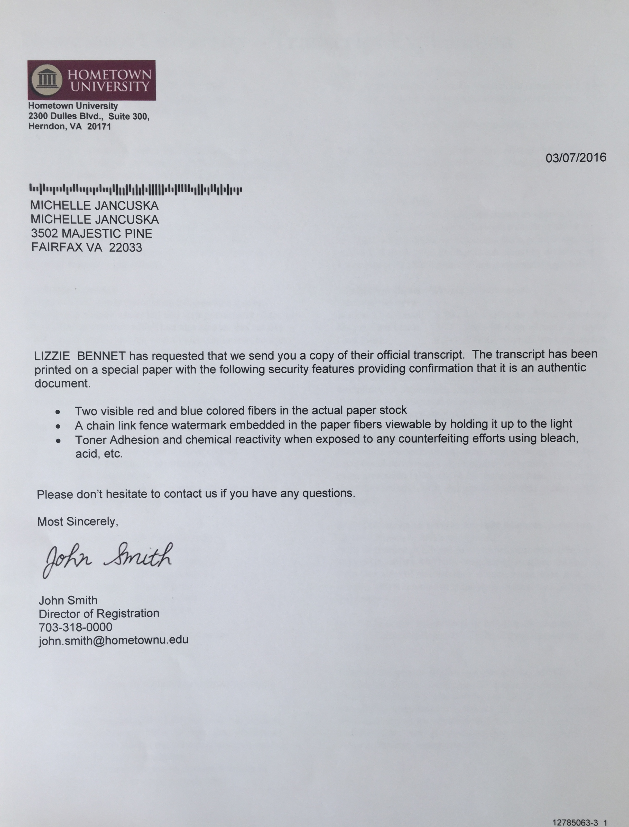
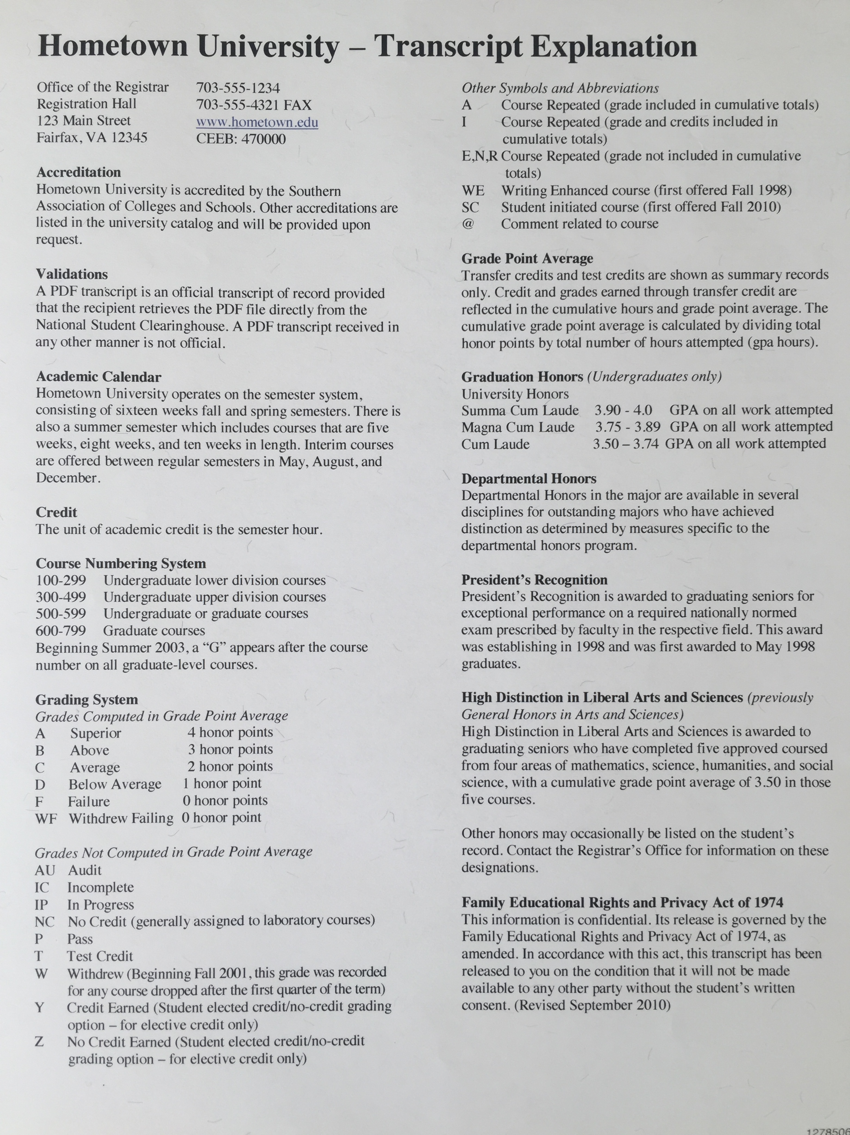
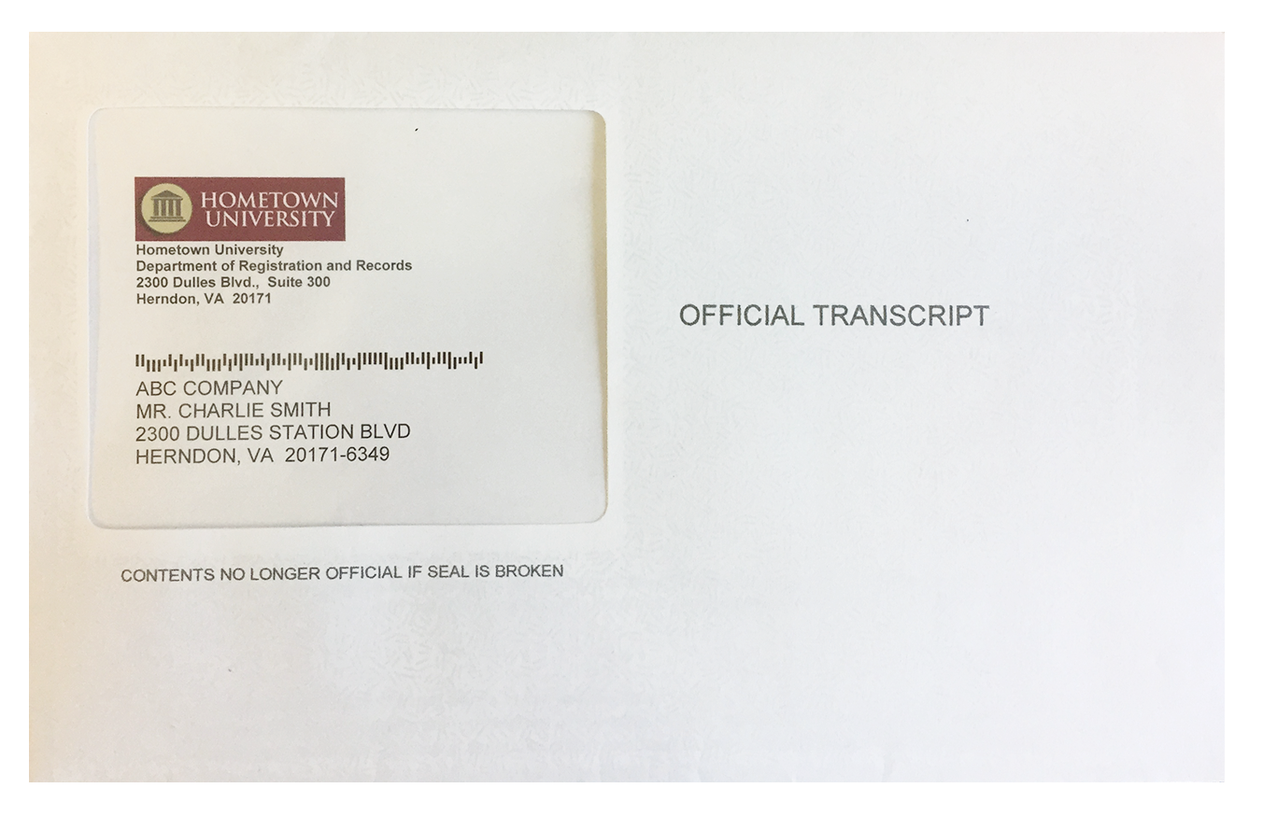

Sample Transcript Package
10 HOMETOWN LN
HERNDON, VA 20171

Slide 42
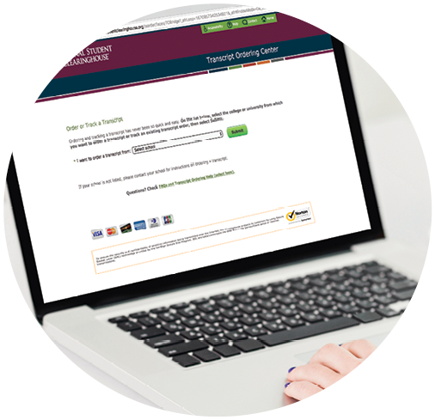
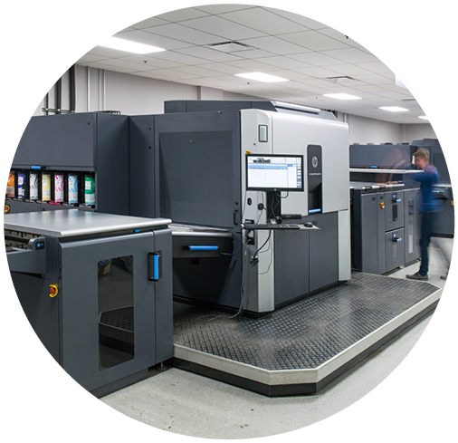


How Does NSC SecurePrint Work?
Student or Alumnus
Your Institution
Print Facility
Submits a transcript order online
Fulfills the order with a PDF transcript
Updates order status and sends print job
Prints, inserts, and mails the transcript

Slide 43
Pricing
Your institution can elect to cover each of the following costs for your students
Shipping and handling (per order)
  Black and white: $ 1.80
  Color: $ 2.40
Express Delivery (per package)
  Domestic: $27.00
  Canada and Mexico: $47.00
  International: $60.00

Slide 44



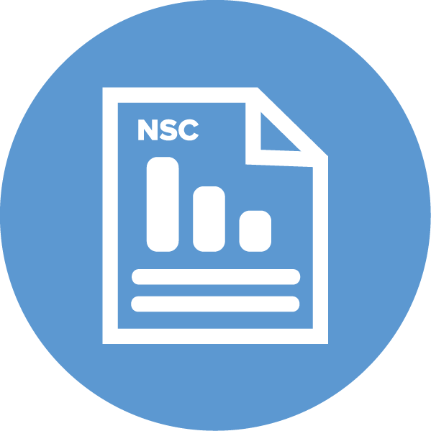

Output
Efficiency
Comparisons
Integration
ANALYSIS READY
Transforms detail report into one row per student
REQUEST FILE RE-RUN
Saves time by
re-running instead
of re-loading file;
up to four times
within 365 days
SIGNATURE AND SNAPSHOT REPORTS
Uses your institution’s data to compare your institution with national sectors
DATA VISUALIZATION
Integrates reporting with graphics for more compelling stories

Slide 45
Analysis-Ready File
Transmitted via Your Secure FTP Account
Organized
Quantitative
One student per row enables concurrent
enrollment to be easily identified
Calculates the number of days between different educational milestones
Standardized Logic
Comprehensive
Retention and persistence
Eight consecutive years of reporting
45

Slide 46
Ability to Re-Run Request Files
Save time by re-running files up to four times over one year
Follow your student cohort for several years to see comprehensive outcomes
Ensure flexibility so any user can
re-run cohort files previously submitted
Retain your filenames to ensure you are re-running the correct file

Slide 47


Download Stored Institution-Level Reports
  Completions
  Persistence & Retention
  National numbers for your school sector

Slide 48
Immediate Collaboration: Visualizations
Access visual representations of your StudentTracker Request File results and our Research Center’s Completions Report
Identify influences impacting your student retention and persistence so you can make the necessary alterations
Tell a story through visualization that you can share with your colleagues and senior leadership team
48

Slide 49



StudentTracker®
^{Premium Service}
VALUE-BASED PRICING
$1,995
> 10,000 students (all levels)
$1,295
4,000 – 10,000 students (all levels)
$795
< 4,000 students (all levels)

Slide 50
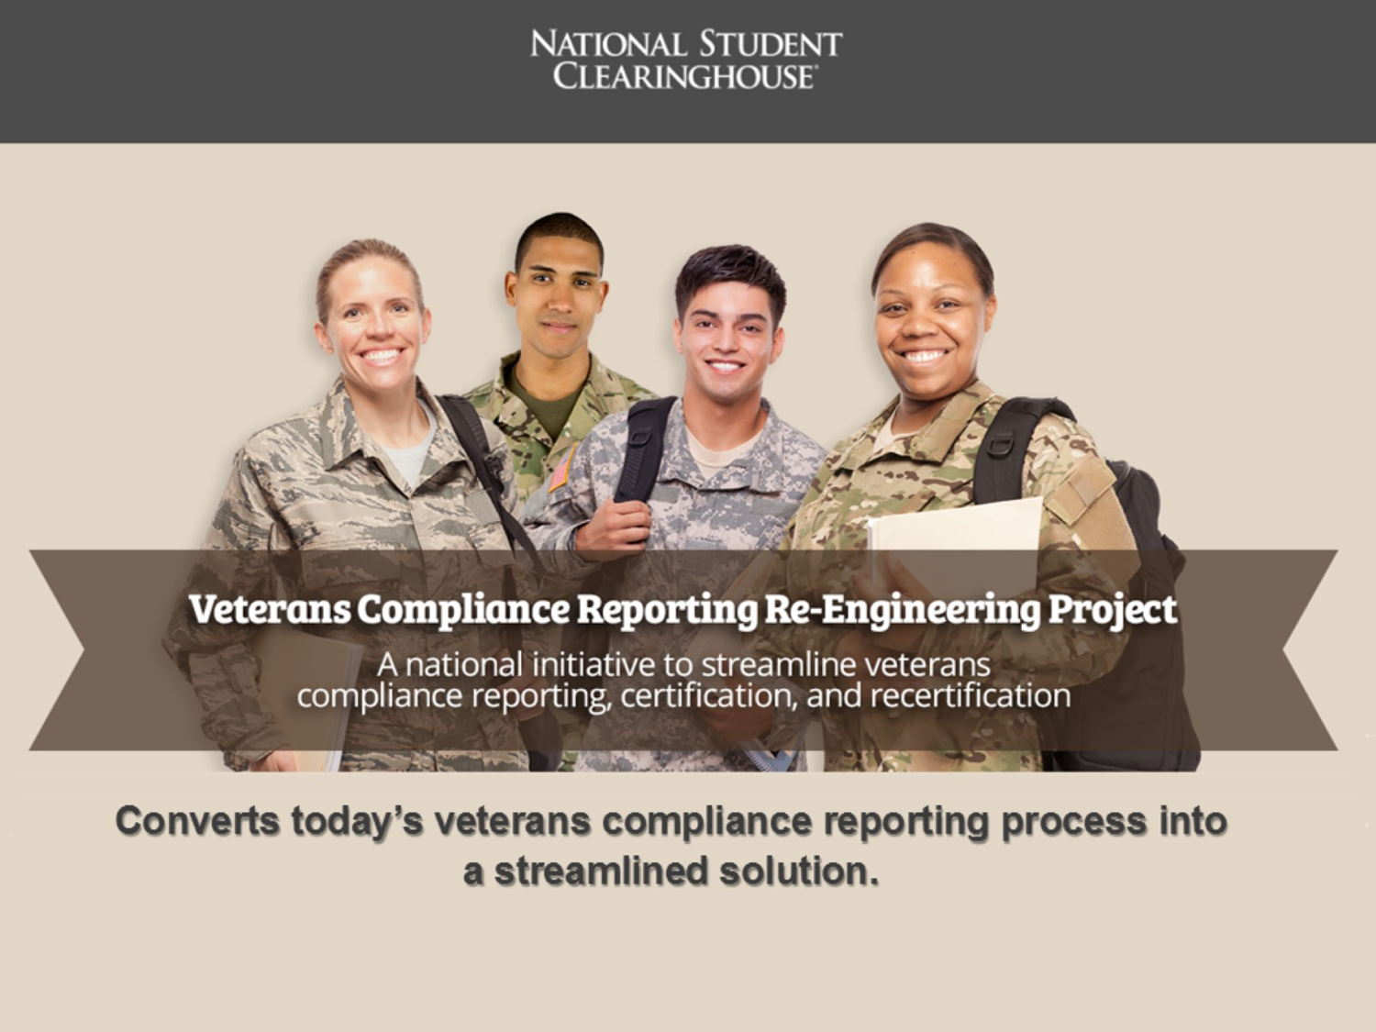
Veterans Compliance Reporting Re-Engineering Project and AACRAO Workgroup
https://www.aacrao.org/signature-initiatives/trending-topics/veterans-service-members

Slide 51

Myhub
Student Profile
Authenticated user
Detailed profile
Education
Enrollment
Transcripts
Co-Curricular
Certs/Dig. Cred.
Diplomas
Institution
One dimensional:
Compliance
Student success
Accountability
Program evaluation
Credential production
Credential verification
Reporting & analysis
Career
Pathways
Research
Skills
Resume
Portable portfolio
Competencies
Experiential record
Multi Dimensional:
Pathways
Program insights
Student optimization
ROI investment
Notes:
So what have we done? We were thinking about mobility, incorruptible, trustworthy and also about the “subject matter”: the student. At the end of the day the convergence point of all this is the individual.
please allow me to talk briefly about the concept and intent of MyHub. We already report Enrollment records on behalf of most of you and
Reuse double helix?
Focus on individual (all comes together)
Outcome: institution=better quality; indiv=portal to carry around portfolio; companies=validations & recruiting/post positions

Slide 52
How Can We Help You Reach Your Goals?
Get the most benefit from the Clearinghouse services by using them all
Are there any services that your school is not yet using?
Would you like more information on any features of current services?

Slide 53
Help Us Help You:
Share what you learned today with others on your campus and reach out to your Regional Director, to schedule an individual review

