Slide 1
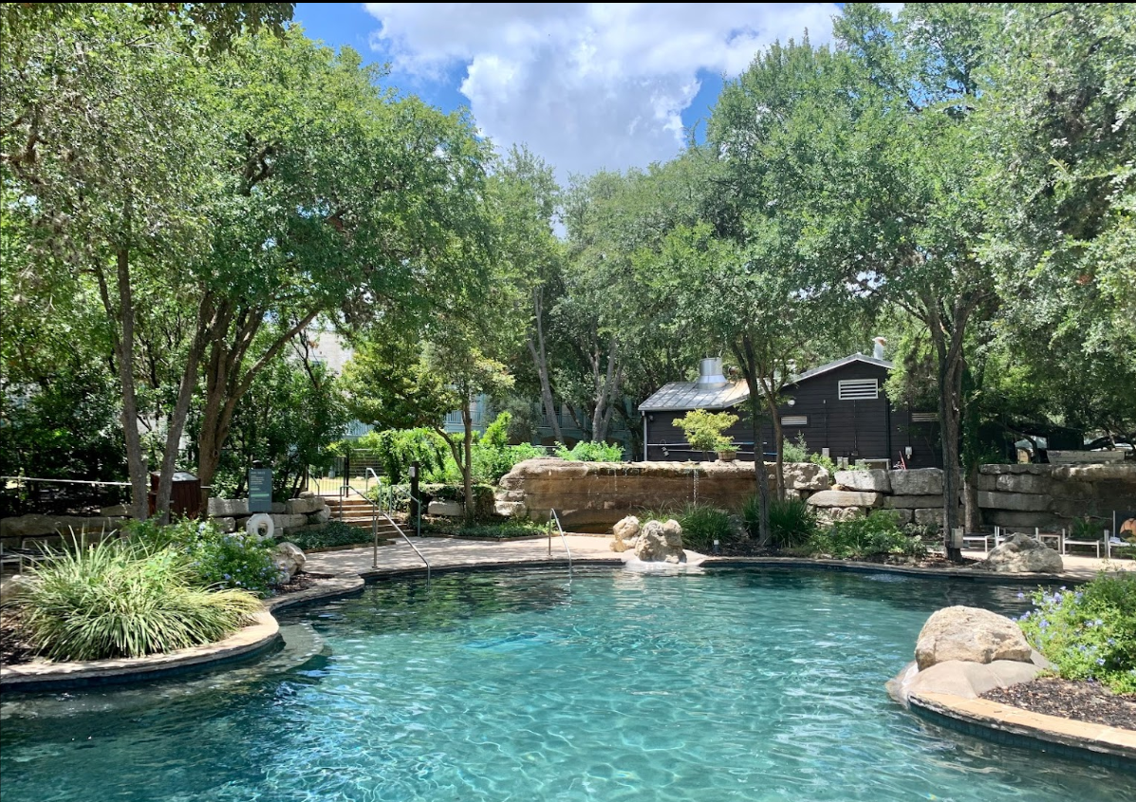


Slide 2
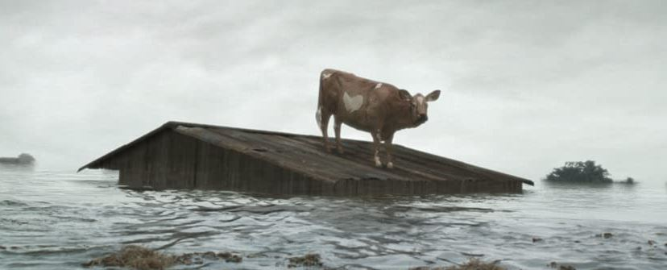


Come Hell or High Water: Preparing for and Surviving a THECB Formula Funding Audit

Slide 3
Come Hell or High Water: Preparing for and Surviving a THECB Formula Funding Audit -
Preparations A through H
Survivors: Betsy Gooding (Northeast Texas Community College - 2022), Scott Branum (Galveston College -2021), and Chris Gore (Kilgore College - 2020)
Session Number: T.3.13
Room: Independence Hall 6
Day: November 8, 2022
Time: 10:20 AM
Please silence turn off your cell phones

Slide 4
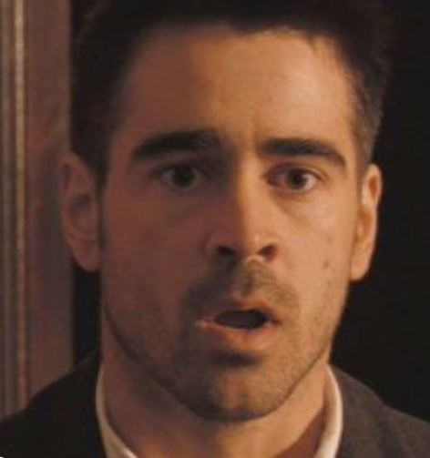
Preparation A: Accept It
THECB Audits –It’s not a matter of if, but when.
Changes in ERP or Registrar?
Texas Administrative Code, Title 19, Part 1, Chapter 13, Subchapter F
THECB Compliance Monitoring Plans Check this regularly.
Watch for THECB notification

Slide 5
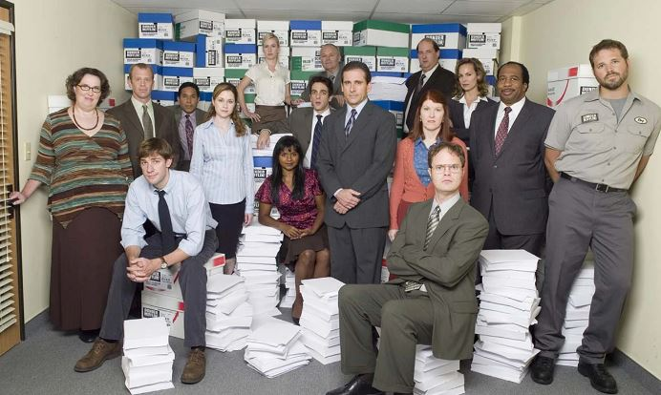
Preparation B: Build your Best Team to Help
Audit Lead/Point Person
Immediate Support: Registrar, Information Technology, Business Office, Human Resources.
Ad Hoc: Financial Aid, cashiers, Payment Plans, Registrar staff, residency clerk, faculty, department chairs, deans, CE specialist, administration, ect.

Slide 6
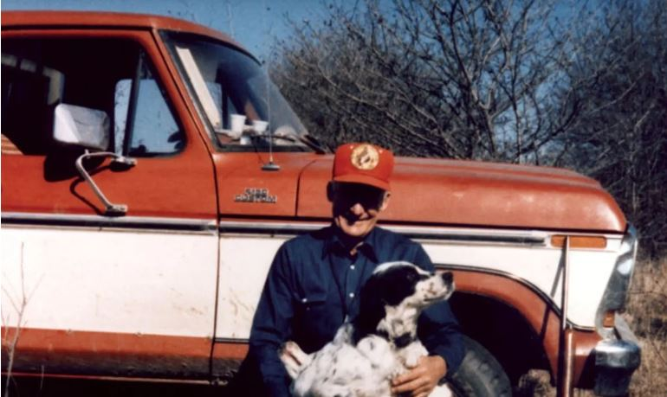
Preparation C: Consider
Best Practices
Ensure data reports are authentic
Verify student financial assistance is awarded in compliance with laws, program eligibility & requirements
Reconcile funds
Security controls, audit logs, data access, monitoring.
Maintain updated internal policies & procedures
Photo: Sam Walton when asked about his vehicle choice, – “If I owned a Rolls Royce, where would I haul my dogs?”

Slide 7
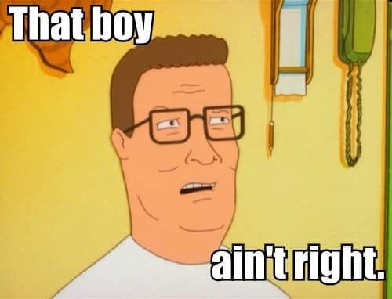
Preparation D: Don’t Throw Stones, But Learn From Others
THECB Compliance Monitoring Reports for FY 2020, 2021, & 2022 Previous Audit Reports Issued
Gives insight and additional contacts/resources.

Slide 8
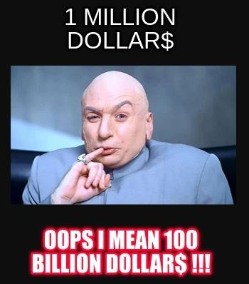
Preparation E: Expand Your Understanding of Audits
Undergraduate & Continuing Ed.
Tuition Payment Processes
Audit Trails
Faculty Credentials
FERPA – legitimate educational interests
Catalog/Course edit capability in your ERP
Job Descriptions
Information Security Standards
Title IX
Timely Distribution of Funds

Slide 9
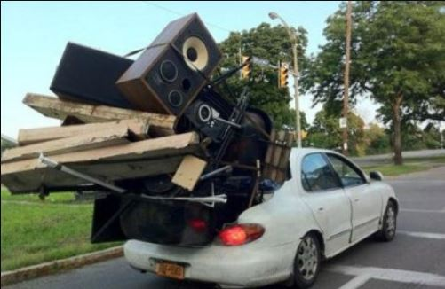
Preparation F: Move Forward
Be proactive
Ask questions for clarification
Avoid delayed responses
Do not make assumptions

Slide 10
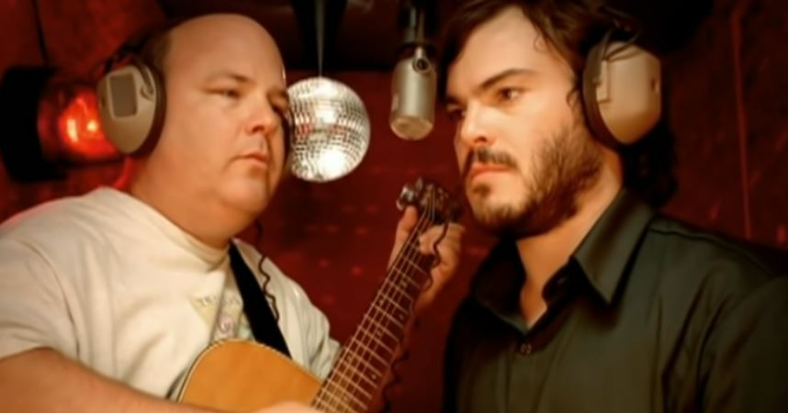
Preparation G: Get After It
Remain focused
Avoid distractions
Make certain you have the internal support required.
Be tenacious….be Tenacious D,
“This is the greatest song…AUDIT in the world.”

Slide 11
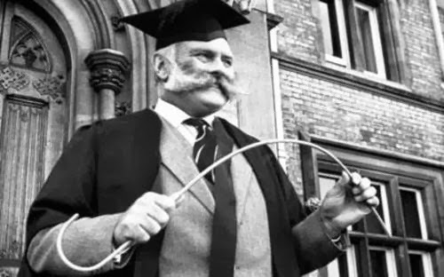
Preparation H: Prepare
“This is going to hurt me more than it will hurt you,” said NO auditor ever.
You know your practices, your data, your ERP, your strengths, & where the skeletons are buried.
Prepare, Prepare More, Prepare until it is your regular routine.
If you remember any slide, keep Preparation H in mind.

Slide 12
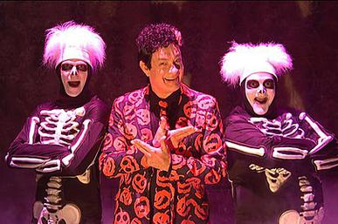
As David S. Pumpkins asks,
“Any Questions?”

Slide 13
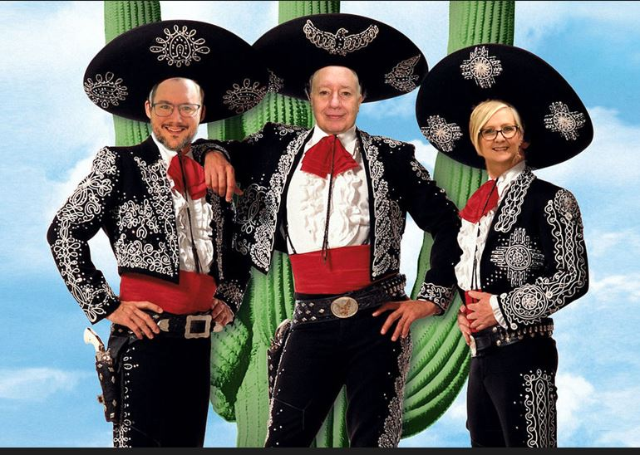
Really, Any Questions?
Betsy Gooding – Northeast Texas Community College bgooding@ntcc.edu
Scott Branum – Galveston College sbranum@gc.edu
Chris Gore – Kilgore College cgore@kilgore.edu

