Slide 1
ApplyTexas Updates
2018-2019 Application Cycle

Slide 2
Table of Contents
Year in Review
ApplyTexas Development Cycle
Application Changes
IV. Administrative Updates
V. Counselor Suite Updates
VI. Continuing Initiatives
VII. Application Testing

Slide 3
Year in Review
Application Totals
Total apps submitted for the Summer 2015-Spring 2016 cycle: 1,509,746
Total apps submitted for the Summer 2016-Spring 2017 cycle: 1,561,286
Increase of 51,540 apps- 3.4%

Slide 4
Year in Review
New Applicant User Names
Applicant user names will now be the email address entered on the profile when a new account is created
This change affects new accounts only and old user names may still be used
ApplyTexas now conforms with other institutional and national common applications that use email addresses as user names

Slide 5
Year in Review
reCATPCHA
reCAPTCHA has been added to the account profile screen and will be added to the submission page

Slide 6
ApplyTexas Development Cycle
July 1: New cycle applications may be opened
July-Sept: Most institutions will open new cycle applications
Aug-Jan: The ApplyTexas Advisory Committee (ATAC) meets 2-3 times to review change requests
January: Technical team sets up the new cycle structure
January: The Advisory Committee approves changes for the upcoming cycle and the list is given to the technical team to begin development
Feb-April: Technical team completes new cycle development
May: Institutions may begin testing new cycle applications and making internal changes in their SIS in preparation for their application opening dates
June 1: QnE becomes available for testing
Ongoing: Technical team works on THECB priorities and non- cycle related projects to enhance all services

Slide 7
ApplyTexas Development Cycle
ApplyTexas Change Request Form
Institutions may request changes to the ApplyTexas application or services through the use of a new change request form. Forms may be obtained by writing to the administrative help desk, applytexas_adm@austin.utexas.edu.
Request forms returned to the help desk will be forwarded to the Coordinating Board and to the ApplyTexas Advisory Committee (ATAC) for review.
Requests are reviewed during meetings in September-January. If approved, most changes will be reflected when next new cycle opens.
Please contact the help desk for more information.

Slide 8
Application Changes
The new cycle of applications will open on July 1st
The new application opening time is now 10:00 a.m. CDT
Application openings after July 1st will remain at 12:01 a.m.

Slide 9
Application Changes
Updates have been made to the following:
Admissions application
  2-Year Application
  Biographical Information
  Educational Background
  Residency
  Extracurricular Activities
  Employment Information
  Essays
  Certification of Information/Payment
  Submission Page/Confirmation Email
  Scholarship application
  Personal Information Page
  Family & Financial Information
  Short Answer Questions

Slide 10
Admissions Application Changes
2-Year Application
The application has been modified and now includes TOEFL and IELTS test information questions and a preliminary visa information page for use by international applicants.
If the applicant responds on the biographical information page that he/she is not a U.S. Citizen or Permanent Resident and cannot qualify for Texas residency through responses to additional questions, the residency page will be replaced on the application with a visa information page.
The international applicant:
  Does not hold permanent residency status
  Has not applied for permanent residency
  Has not lived in Texas for 36 consecutive months leading up to high school graduation of completion of the GED
  Is not a foreign national with a qualifying visa to domicile in Texas
Questions on the educational information page ask if TOEFL and IELTS tests have been taken and also ask the applicant to indicate his/her native language.

Slide 11
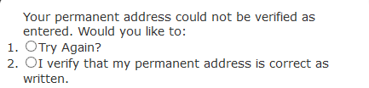
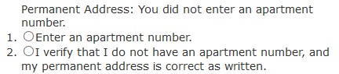
Application Changes
Biographical Information Page
New Address Standardization Software
The new software will correctly and accurately interpret an address in all of its variations and provide a standardized and deliverable address on the application.
If the applicant enters an unverifiable address, a message will pop up asking if the address should be entered again or requiring verification that it is correct as written
If the address may have an apartment number, the applicant must enter the number or verify that the address is correct as written
The applicant will not be able to save the page until the address is correct or verified as written.

Slide 12
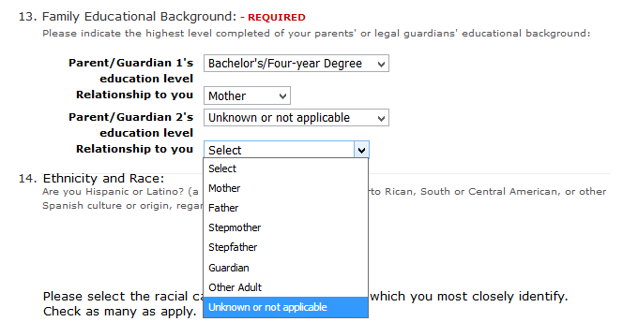
Application Changes
Biographical Information Page
Father” and “Mother” have been changed to “Parent/Guardian 1” and “Parent/Guardian 2”.
“Unknown or not applicable” has been added to the Parent/Guardian 2’s relationship menu. This allows applicants with only one parent to ignore the second “Parent/Guardian” relationship if it is not applicable.

Slide 13
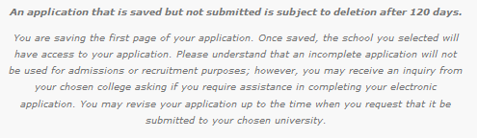
Application Changes
Biographical Information Page
Extend “application in progress” time
Previously, any applications that were started, but not submitted, were subject to removal from the site after 120 days.
With the opening date moving to July 1, this will be extended to 180 days.

Slide 14
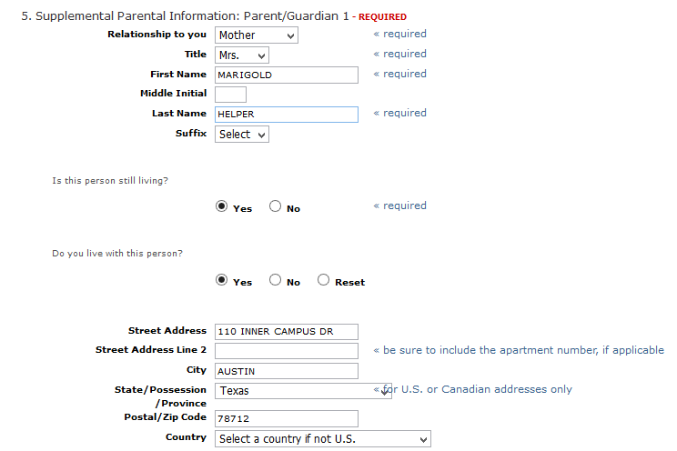
Application Changes
Biographical Information (continued) Page
Autofill Address Information
On the supplemental parent information question, the parent’s address information will be imported from the profile if the student indicates that he/she lives with the parent.

Slide 15
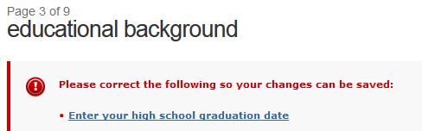
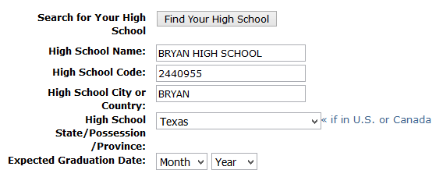
Application Changes
Educational Background Page
A high school graduation date will now be required of all applicants if high school information is entered.

Slide 16
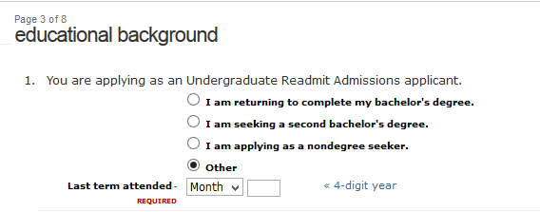
Application Changes
Educational Background Page
A new question has been added to the Readmit Undergraduate application asking the applicant why he/she is applying for readmission and for the last semester attended.

Slide 17
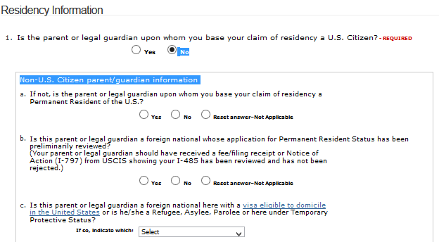
Application Changes
Residency Page
A new “show/hide” feature has been added to the question asking the applicant if his/her parent or legal guardian is a U.S. Citizen. Only if the applicant answers “no” will additional questions about residency be asked.

Slide 18
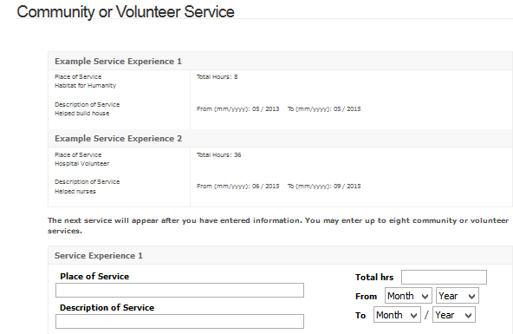
Application Changes
Community or Volunteer Service Page
The “year” of service field has changed from an open text field to a drop down menu.

Slide 19
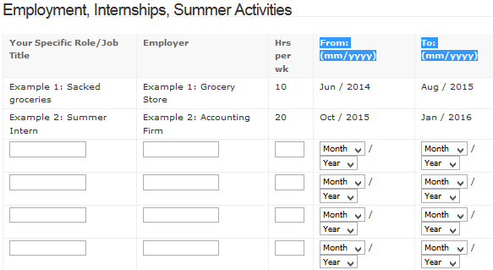
Application Changes
Employment, Internships, and Summer Activities
The open text “year” fields have been replaced with pull down menus.

Slide 20
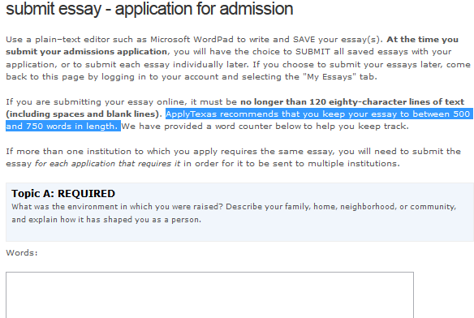
Application Changes
Essay Page
The suggested essay length has been changed to 500-750 words.

Slide 21
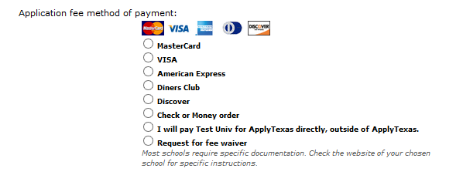
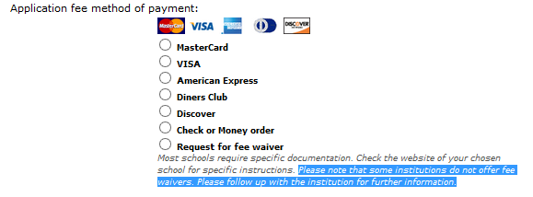
Application Changes
Payment Section
Additional text has been added to the fee waiver payment option saying that some institutions do not offer waivers and to follow up the institution for more information.
Current waiver message:
Modified waiver message:

Slide 22
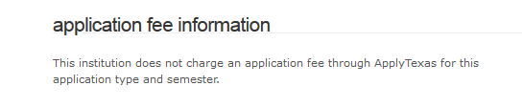
Application Changes
Payment Section
If an institution doesn’t charge an application fee on ApplyTexas, applicants will see the following message on their applications:

Slide 23
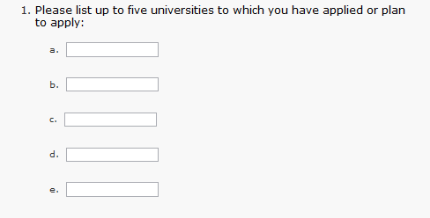
Scholarship Application Changes
Personal Information
Applicants were previously asked to list up to five universities that they had either applied to or planned to apply to:
This question has been removed from the application.

Slide 24
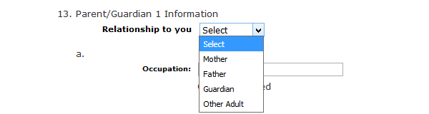
Scholarship Application Changes
Family & Financial Information Page
“Father” and “Mother” have been changed to “Parent/Guardian 1” and “Parent/Guardian 2”.
The applicant will select the relationship from a drop down menu.

Slide 25
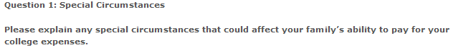
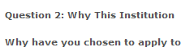
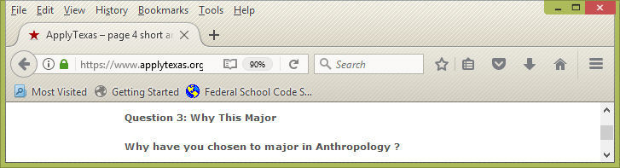
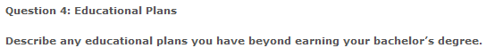
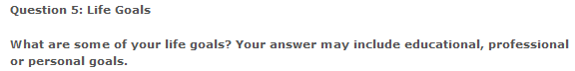
Scholarship Application Changes
Short Answer Questions
Question wording has been updated for clarity.

Slide 26
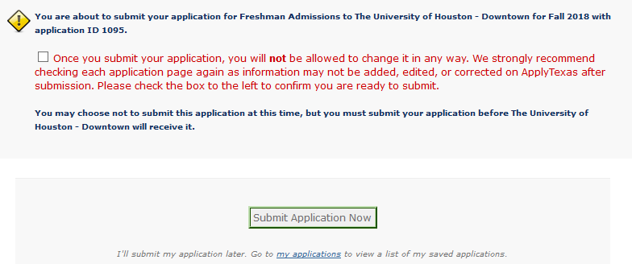
Application Changes
Submission Page
New wording and a checkbox have been added to the submission screen alerting the applicant that submitted applications may not be changed on the ApplyTexas site.
The box must be checked before the application may be submitted.

Slide 27
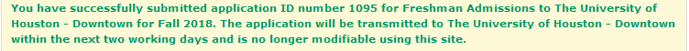
Application Changes
Submission Confirmation
After an application is submitted, the next screen displays a message that the submission was successful and that the application will be sent to the receiving institution within two business days.
In addition, an update was made to the confirmation email that the student receives after submission. The wording now reads:
“Your application will be sent to the above school in the next two working days, and there may be subsequent overnight processes necessary at your target institution before they are able to contact you. Please also keep in mind that weekends and holidays may further delay this communication.”

Slide 28
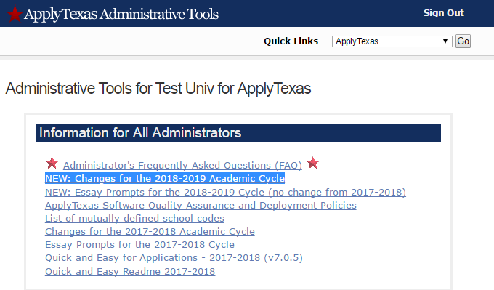
Administrative Updates
EDI Changes
New cycle changes that affect EDI can be found on the institution’s administrative site.

Slide 29
Administrative Updates
Site Security
ApplyTexas:
  Sends applications to the NSC through a secure SFTP connection
  Further encrypts Social Security numbers and partial credit card data before transmission
  Site is scanned each month by Trustwave for PCI compliance. Certificate can be found on the administrative site
  Site is now given a deep penetration scan annually by the UT Austin Information Security Office
  ****Custom question responses do not receive double encryption before transmission. Personal and sensitive information, e.g. Social Security numbers or HIPAA information, should not be requested using a custom question.****

Slide 30
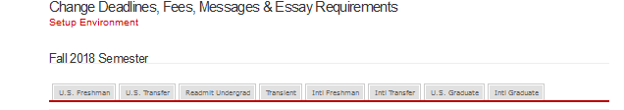
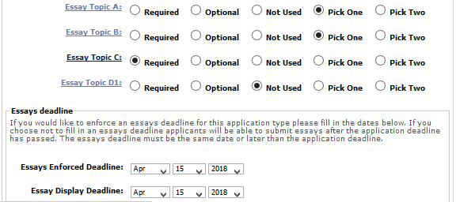
Administrative Updates
Custom Essay Deadlines
Institutions may now customize essay deadline by application type. The custom deadline must be on or after the application deadline. If a specific deadline isn’t entered, essay submission will continue the same as it has, with no deadline.
Customize the deadline using the “Change Deadlines, Fees, Messages & Essay Requirements” section of the executive menu.

Slide 31
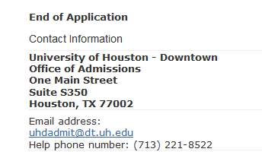
Administrative Updates
Application View/Contact Information
Institutional contact information from the submission email has been added to the application view at the end of the application.

Slide 32
Counselor Suite Updates
International Freshman Application Information
Previously, only application information for students applying as a U.S. Freshman to a 4-year institution or students applying to a 2-year institution were included in the Counselor Suite.
International Freshman application information is now included in the suite as well.

Slide 33
Continuing Initiatives
Expand Data Elements
  Additional information will be added to the admission application reports that are downloaded from the administrative site:
  Parent education information
  Transfer credit
  High school graduation date
  High schools attended with to/from dates
  Colleges attended with to/from dates
  These changes will be added as time permits.

Slide 34
Application Testing
New Cycle Test Site Is Open
The test application can be found at https://www.applytexas.org/test/adappc/gen/c_start.WBX .
For questions on completing test applications, contact the help desk and please send us your comments and questions.

Slide 35
Questions? Need Help?
Contact us at:
  applytexas_adm@austin.utexas.edu

Slide 36
ApplyTexas
Many Schools One Application

