Slide 1

The 85th Legislative Session
Dustin Meador – Director of Government Relations

Slide 2
The 85th Regular Session by the Numbers
Historically Low Productivity
Session defined by House/Senate tension
Lowest Passage Rate for Bills in the Modern Era:
  18% of filed bills passed (16% of House bills, 22% of Senate bills)
  Lowest total number passed
    1,211 HB/SBs passed in 2017
  Most bills filed since 2009
    6,631 bills filed in 2017;
    7,419 in 2009
  50 Bills vetoed by the Governor
    Bill related to Trustee elections only community college related bill vetoed

Slide 3
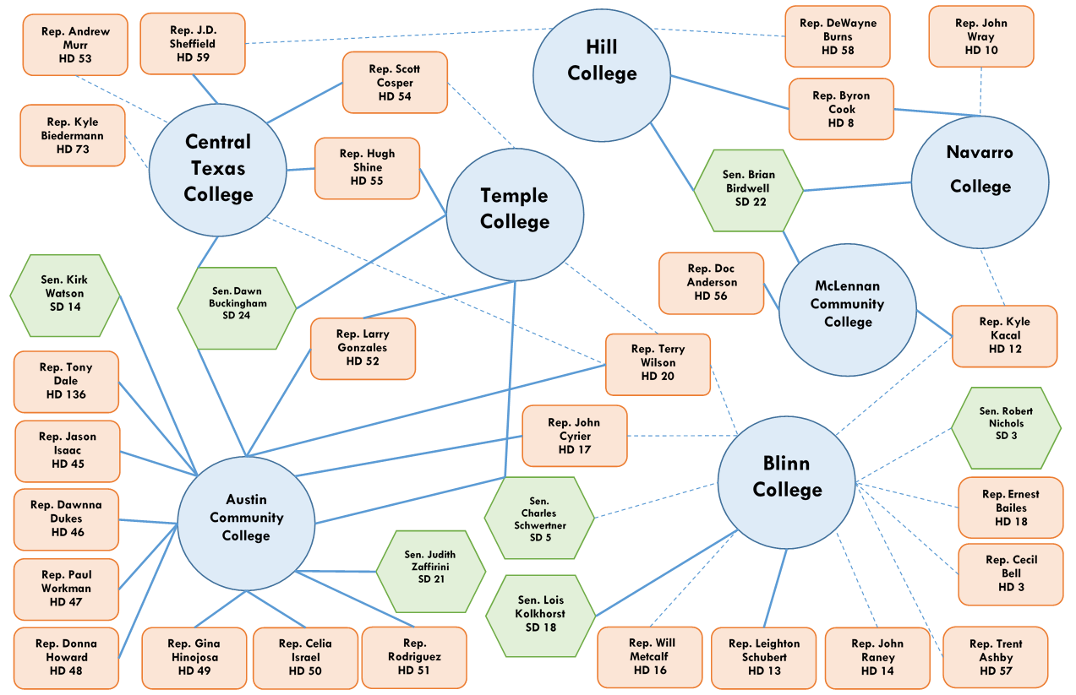
TACC Regional Strategy

Slide 4
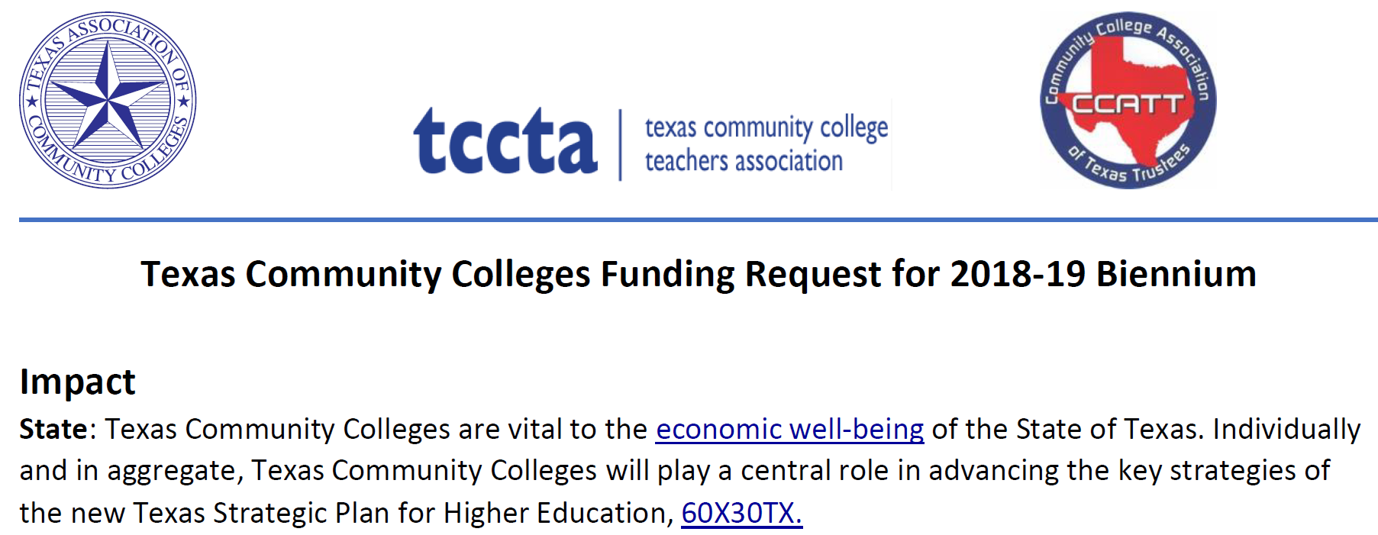
Unified Advocacy Approach

Slide 5
Policy Victories
HB 2994: Continuing Education (CE) reimbursement
  Author Rep. Trent Ashby (R-Angelina); sponsor Sen. Juan “Chuy” Hinojosa (D-McAllen)
  Ensures state reimbursement for continuing education courses taught to high school students or taught to adults with waived tuition.
SB 2118: Authorization for Baccalaureate Degrees
  Author Sen. Kel Seliger (R-Amarillo); sponsor Rep. Sarah Davis (R-Houston)
  Allows for limited authorization from THECB in nursing, applied technology, applied science, early childhood education, and dental hygiene (TJC only)
  $6B in tax valuation, positive financial health required

Slide 6
Policy Victories
SB 719: Reporting Requirements for Community Colleges
  Requires THECB to collect data on participation of persons with intellectual and developmental disabilities enrolled in a workforce education programs
  Amended to include a pilot program to study campus level reporting of finances
  Overrides reporting rider (old Rider 23, new Rider 22)
No Major Dual Credit Bills Passed
Creation of a new college by an ISD failed to pass

Slide 7
Policy Setbacks
HB 2194: Adding a trustee to the Weatherford College board from outside the taxing district.
  State mandated a trustee appointment for second consecutive session
  Precedent set for representation from maintenance tax county
No significant credit transfer legislation
  Workgroup created in the Senate, bills by Sen. West failed to reach Governor

Slide 8
Other Significant Legislation
SB 4: “Sanctuary Cities” Bill
  Campus police may not “adopt, enforce, or endorse a policy under which the entity or department prohibits or materially limits the enforcement of immigration laws.”
  A campus police department may not prohibit or limit a commissioned peace officer from inquiring into the immigration status of a person under lawful detention or arrest.
  Discrimination prohibited; complaint process and equitable relief process established. Civil penalties created for violations.
  Potential removal from office if person holding “elective or appointive office of a political subdivision” violates provisions of the new law.

Slide 9
Other Significant Legislation
HB 2223: Co-Requisite Developmental Education
  Requires adoption of co-requisite model for developmental education.
  Incremental implementation required, leading to 75% of developmental education students enrolled in co-requisite model:
    2018-19: at least 25%
    2019-20: at least 50%
    2020-21: at least 75%
  Formula funding for developmental education reduced from 27 to 18 credits per student. (27 if coursework is English for non-English speakers)
  Rulemaking process underway at THECB

Slide 11
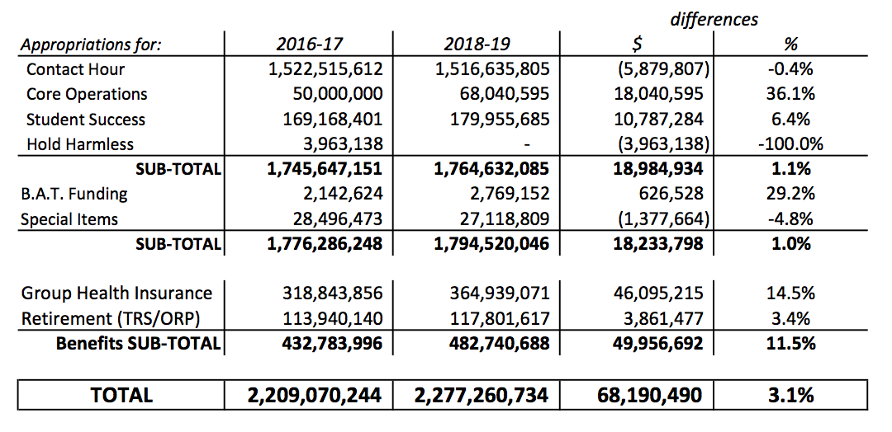
General Appropriations Act - 85th Legislature

Slide 12
General Appropriations Act - Summary
The instructional appropriation for community colleges is $1.764 billion for the 2018-19 biennium;
a $19 million increase from the 2016-17 biennium.
$1.52 billion was appropriated to Contact Hour funding.
  The average rate per contact hour rose slightly from $2.69 per CH to $2.70 per CH.
  Base year contact hours declined 0.7-percent from the previous biennium (280,941,841 contact hours compared to 282,919,371 contact hours).
Funding for Core Operations was increased from $50 million to $68 million (36% increase). Core funding for each college district is $1.36 million for the 2018-19 biennium; an additional $360,800.
$180 million was funded for Student Success Points in 2018-19.
  Student success points increased 7.0-percent from the last biennium (1,048,949 student success points compared to 980,204 student success points).
  The 2018-19 rate per student success point is $172. The 2016-17 rate was $173 per point.

Slide 13
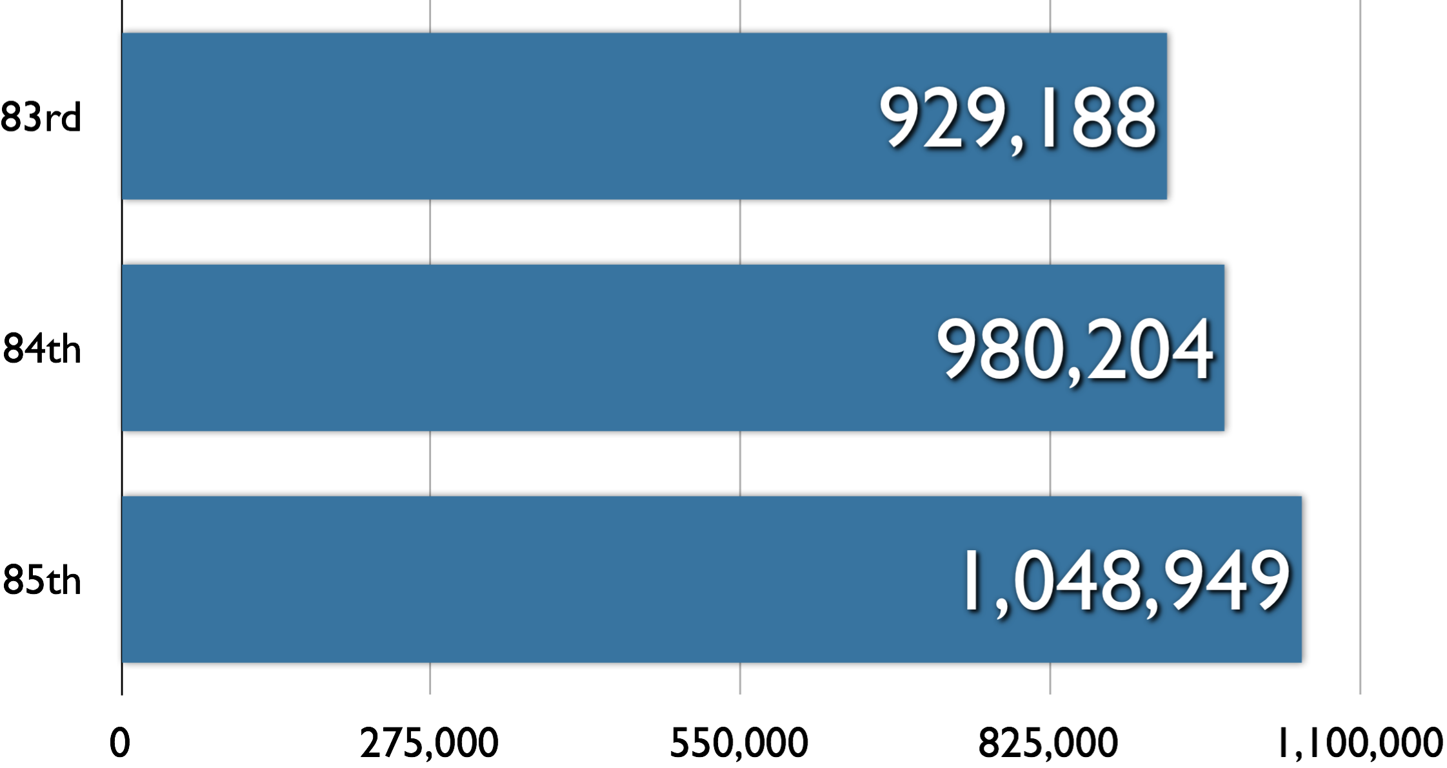
Student Success Points
+5%
+7%

Slide 14
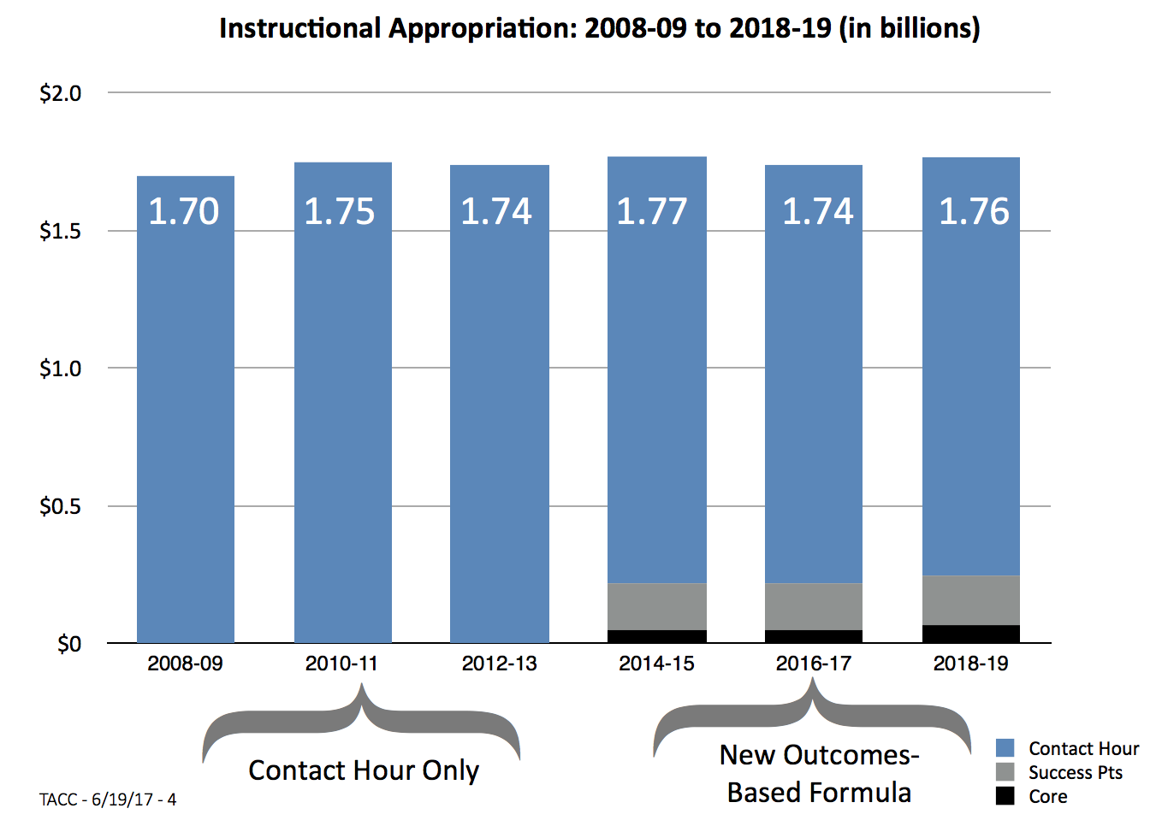

Slide 15
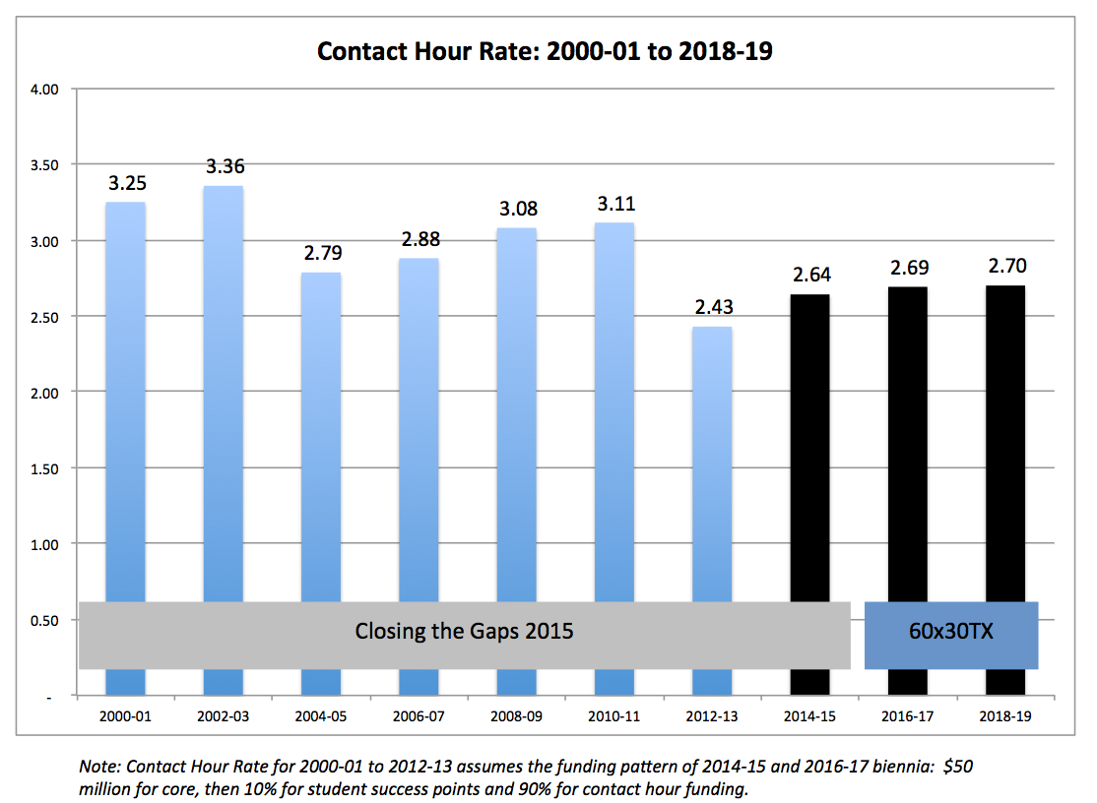

Slide 16
Looking Ahead to Special Session
Special Session to began July 18, 2017
20 Items anticipated to be on the call
Property Tax rollback rates primary issue for TACC.
  TACC will seek an exemption for college districts

