Slide 1
Residency
July 2017
Summer TACRAO Conference
Kathy Cordova
Assistant General Counsel
THECB

Slide 2
Residency Overview
Most Recent Rule Changes--October 2016
Determination of Residency Status Chart
Definition of “Erroneously Classifies a Person as a Nonresident” repealed
Definition of Deferred Action added
Clarified
  “Temporary absence” and “Habitable real property”
Notes:
Section 21.28

Slide 3
Highlights of Changes
Definition Repealed:
Erroneously classifies a person as a nonresident
Change in Interpretation of TEC Sec. 54.056(b):
(b) Regardless of the reason for the error, if an institution of higher education erroneously classifies a person as a nonresident of this state, the institution shall charge resident tuition to the person beginning with the academic term in which the institution discovers the error. The institution immediately shall refund to the person the amount of tuition the person paid in excess of resident tuition.

Slide 4
Highlights of Changes
Current 19 TAC Sec. 21.28(b)
(b) If an institution erroneously classified a person as a nonresident of this state under this subchapter and the person is entitled or permitted to pay resident tuition, the institution shall charge resident tuition to the person beginning with the semester in which the institution discovered the error. Regardless of the reason for the error, the institution shall immediately refund to the person the amount of tuition the person paid in excess of resident tuition.

Slide 5

Scenarios: Independent vs. Dependent
  How can I tell if I am an
  INDEPENDENT
  or DEPENDENT student
Notes:
What facts are missing?

Slide 6
Scenarios: Independent vs. Dependent
  Presumed to be independent
  If:
Notes:
What facts are missing?

Slide 7
Independent Student Criteria
24 yrs or older by first day of class
Married
Provides more than half of support to own child or other dependents
Is a veteran of US Armed Forces
Both parents are deceased or the student is a ward of court
Working on a master’s or doctoral degree
Classified as an independent by Financial Aid Office
Notes:
Veteran for purposes other than for training. A student who does not meet one of the criteria outlined above may be classified as an independent student only if he or she submits documentation (most recent year's tax return) that he or she provides fifty (50) percent or more of the cost of attendance for independent, in-state students as defined by the financial aid office at the institution (exclusive of federal, state, and institutional aid or scholarships).

Slide 8
Scenarios: Independent vs. Dependent
  But Can Be Rebutted If Parent Claimed Student On Income Tax Form
Notes:
What facts are missing?

Slide 9

Scenarios: High School Transcript
  High School Graduation
  or GED
  Do I have to get my transcripts or eventually my high school graduation diploma accredited or approved by the state of Texas? If so how?
Notes:
What facts are missing?

Slide 10
Scenarios: Durational Requirement
  My daughter is planning to apply for a college in Texas for academic year 2019. In order to attend medical school,
  she has to apply 1 year prior to that--in 2018.
  Are we supposed to be have completed the 1-yr residency requirement by 2018 (when she applies) or by 2019?
  We were planning to move to Dallas at the end of 2017. I am very confused as to whether my daughter will be eligible as a resident of Texas.
  Do we count the year that she is joining the college there or should we count the year she is applying (For Medical school, we apply 1 year before). Please advise.
Notes:
What facts are missing?

Slide 11
Scenarios: Continuing Resident Status
  I work for a Texas community college and am trying to figure out if SB1528 status ever expires.
  It is my understanding that it does not, however, I cannot find that written anywhere and was hoping for some clarification.
  The reason I am asking is that some students attend as SB 1528 students and then quit taking courses for an extended period of time due to a number of reasons.
  Would the student have to prove once more that they qualify for this status or would it essentially be, "once you qualify as SB1528, you stay SB1528" unless your residential status changes?
Notes:
What facts are missing?

Slide 12
Scenarios: Continuing Resident Status
  SB 1528 is codified at TEC Sec. 54.052
  Sec. 54.052. DETERMINATION OF RESIDENT STATUS. (a) …the following persons are considered residents of this state for purposes of this title:
  *
  *
  *
(3) a person who:
(A) graduated from a public or private high school in this state or received the equivalent of a high school diploma in this state; and
(B) maintained a residence continuously in this state for:
(i) the three years preceding the date of graduation or receipt of the diploma equivalent, as applicable; and
(ii) the year preceding the census date of the academic term in which the person is enrolled in an institution of higher education.
Notes:
What facts are missing?

Slide 13
Scenarios: Continuing Resident Status
  19 TAC Sec. 21.26 Continuing Resident Status
  (a) Except as provided under subsection (b) of this section, a person classified by an institution of higher education as a resident of this state under this subchapter is entitled, without submitting the information required by §21.24 and §21.25 of this subchapter, to be classified as a resident by any institution in each subsequent academic term in which the person enrolls unless the person provides information to the institution that indicates a change in resident status is appropriate as indicated in §21.27 of this subchapter.
Notes:
What facts are missing?

Slide 14
Scenarios: Continuing Resident Status
  19 TAC Sec. 21.26 Continuing Resident Status
  (b) If a person is not enrolled in an institution of higher education for: two or more consecutive regular semesters, then the person must reapply for resident status and shall submit the information required in §21.24 and §21.25 of this subchapter and satisfy all the applicable requirements to establish residency.
Notes:
What facts are missing?

Slide 15
Scenarios: Deferred Action for Childhood Arrivals (DACA)
  I am having trouble filling out my application on ApplyTexas. I don’t understand the part where it asks about citizenship. I have a social security and a temporary work permit because of DACA. I have lived in Texas since I was 7 years old. I have proof of that. I graduated from high school from Texas as well. I am currently attending a community college and am trying to transfer to a university. How do I fill out the application since it is not clear. Also will I get to pay residential tuition or will I have to pay non-residential tuition? Thank you so much for your time.
Notes:
What facts are missing?

Slide 16
DACA- Continued
19 TAC Sec. 21.22(5)
Deferred action
Discretionary determination to defer a removal action of an individual as an act of prosecutorial discretion. An individual who has received deferred action is authorized by Department of Homeland Security (DHS) to be present in the United States, and is therefore considered by DHS to be lawfully present during the period deferred action is in effect.

Slide 17
DACA- Continued
DACA is one form of deferred action. Student may request consideration of DACA if the student:
Was under the age of 31 as of June 15, 2012;
Came to the United States before reaching his 16th birthday;
Has continuously resided in the United States since June 15, 2007, up to the present time;

Slide 18
DACA- Continued
Was physically present in the United States on June 15, 2012, and at the time of making your request for consideration of deferred action with USCIS;
Had no lawful status on June 15, 2012, meaning that:
  He never had a lawful immigration status on or before June 15, 2012, or
  Any lawful immigration status or parole that he obtained prior to June 15, 2012, had expired as of June 15, 2012;

Slide 19
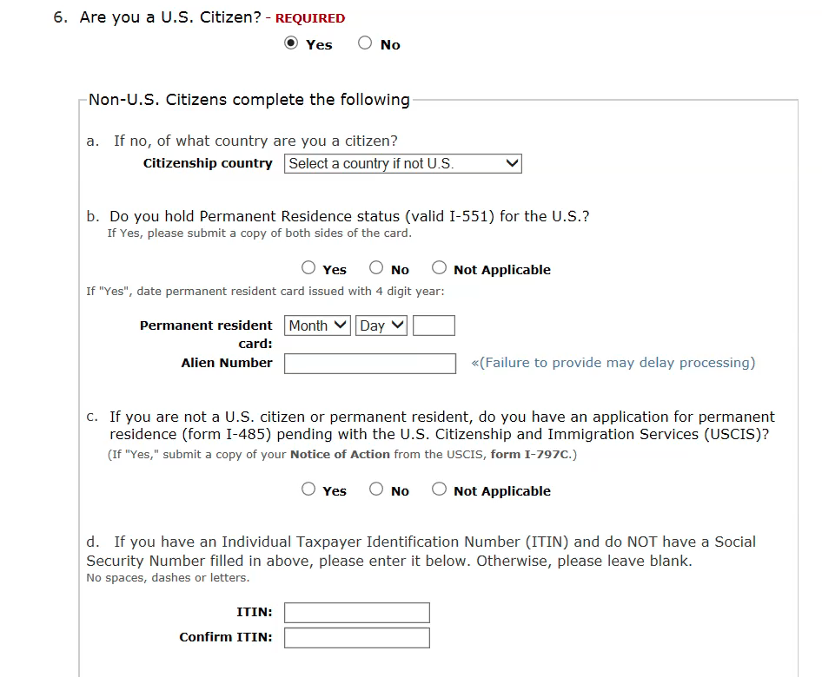

Slide 20
DACA- Continued
Are currently in school, have graduated or obtained a certificate of completion from high school, have obtained a General Educational Development (GED) certificate, or are an honorably discharged veteran of the Coast Guard or Armed Forces of the United States; and
Has not been convicted of a felony, a significant misdemeanor, three or more other misdemeanors, and do not otherwise pose a threat to national security or public safety.

Slide 21
DACA FACTS
May establish domicile in the United States.
NOT an automatic grant of in-state tuition. Student must provide sufficient documentation to support the objective indicia of domiciliary intent listed in Texas rules.

Slide 22
Thank you for serving Texas students!
Questions?
Kathy Cordova
Assistant General Counsel
THECB
Kathy.Cordova@thecb.state.tx.us
512-427-6144

