Slide 1
Making the Most of Your Clearinghouse Services
How our “Many to One to Many” model provides significant benefits
to the education community
Joe Roof, Regional Director

Slide 2
Agenda
Clearinghouse Value and How We Work Across You Campus Today
Enrollment Reporting and NSLDS
The Big Four
  Transcript Services
  Reverse Transfer
  StudentTracker Premium Service
  Student Access to their Clearinghouse data (My Hub)
Other Initiatives and NSC Research Center
Clearinghouse Academy and Customer Service
Notes:
Thank you very much for taking time out of your busy day to join us today. My name is Paul Taylor, one of the eight Regional Directors here at the Clearinghouse and I am pleased to have Dannette Sullivan, from the Northeast Region who will serve as the host for this call. It is indeed a pleasure to have this opportunity to talk with you all about our etranscript service.
While all of you are more than welcome to remain on this webex, it is designed to discuss the benefits of the eTranscript solution that is available for Ellucian schools: Banner, Colleague and Power Campus.
The purpose of our presentation today is to provide you with an overview of our industry leading eTranscript solution in a way that motivates you to contact your regional director to learn more about how this exciting service works and how it can be quickly implemented at your institution.
In respect for your time, we will not get into a deep dive of the many options available and technical aspects of the solution.

Slide 3

Our Beginnings
Notes:
As many of you know, the Clearinghouse was founded in 1993 to serve the education community by facilitating the exchange and understanding of student enrollment, performance and related information.

Slide 4


National Student Clearinghouse
Founded in 1993, now serving more than 3,600 schools representing 98% of all students enrolled at public and private postsecondary institutions.

Slide 5
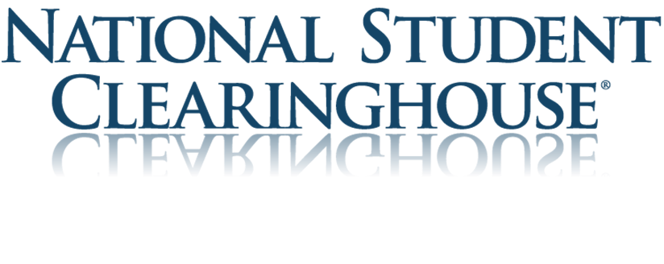
NSC is built on a “many to one to many” business model
Data Re-use
COMPLIANCE
VERIFICATIONS
DATA PROVIDERS
RELEVANT DATA REQUESTORS
ACCOUNTABILITY
RESEARCH
STUDENT SUPPORT
School Data
Wage Data
Private 3rd Party Data
DATA EXCHANGE

Slide 6


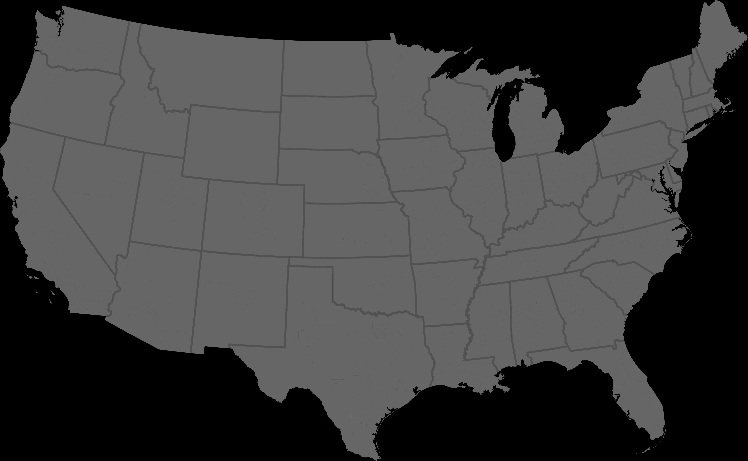
Our Value to You
The National Student Clearinghouse today…
We are YOU
Data
Coverage & Usage
Innovative Solutions
Notes:
Since then, you have told us that we bring value to the community we serve in three distinct ways:
We are your trusted partner, standing shoulder to shoulder with you to address the issues that are most important. Successfully and securely processing an unmatched 1 billion plus records annually, the Clearinghouse is the nation’s largest electronic education data exchange ecosystem.
One of the things we most admire about the higher education community is the sense that we are all in it together to serve a higher purpose, for the greater good. In that sense, you trust us to hold and maintain your data, and we have never let you down. That data represents 97% of enrollments nationally, ensuring census coverage. It is precisely because we hold this enrollment and degree data that uniquely allows us to provide a variety of very important value added uses of that data, including our Snapshot and Signature reports, StudentTracker capabilities, Time to Degree research, and many other research initiatives that bring valuable and actionable insights to the community at large.
By listening to you, our partners, we continue to bring innovative solutions to the community, such as our exciting new Reverser Transfer initiative and the work we have begun in the area of veterans benefits.
You demand superior customer service. We understand this obligation and have organized our operations to deliver on this commitment to you, your students and alumni…in short, WE ARE YOU!

Slide 7
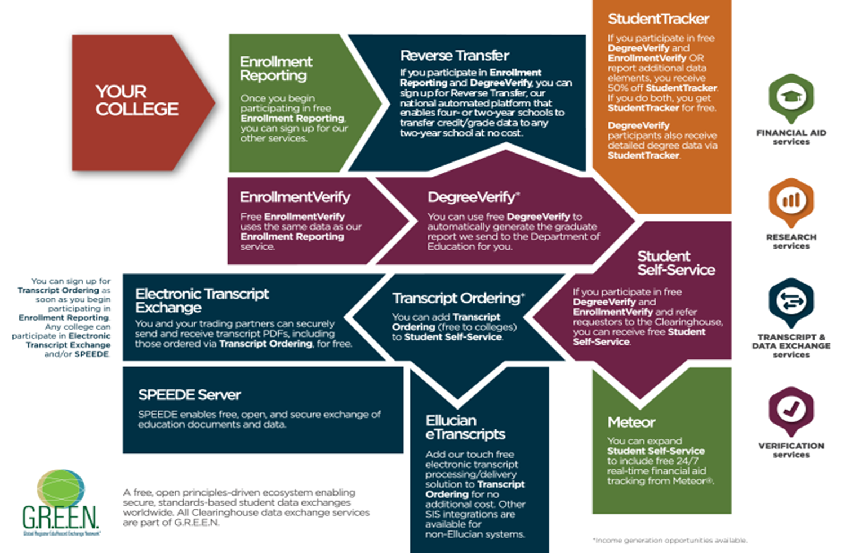

Slide 8
Enrollment Reporting and NSLDS
Reporting Enrollment Data for Title IV Compliance

Slide 9

Acceleration of NSLDS Compliance Changes
NSLDS requires new data submission format for SSCR roster
New less-than-half-time status
AGD requirement
Reporting X or Z records without program-level data no longer negatively impacts Enrollment Reporting Statistics
No changes for 15 years
15 changes in 5 years (2011-2015), including 8 changes between 2014 and 2015
Changes growing in frequency and complexity
2014-15 GE reporting due
Program-level and Q status (for 3/4 time) requirements
“X” enrollment status required for resolving incorrectly reported program
NSLDS Enrollment Reporting Statistics Page released
NSLDS Enrollment Roster response required at least twice a year
Gainful Employment (GE) disclosure requirements take effect
2011-12 GE reporting due
NSLDS institutes new certification date logic for summer and non-compulsory term reporting
1996
1997-2010
2011
2012
2013
2014
2015
2016
NSLDS Enrollment Roster response spacing adjustment requiring updated format
New instruction to report unknown or unavailable student addresses as (“UK”) in address fields
Initial GE reporting deadline
Reporting frequency changed to every 60 days
Roster errors must be corrected within 10 days
Extended GE reporting deadline
2008-09 through 2013-14 GE reporting due
LEGEND
Format changes
Date-sensitive changes
Other changes
NSLDS requires schools and their servicers to respond within 15 days of SSCR roster receipt

Slide 10
The past three years of compliance changes have led to challenges across the education community including:
Creation of and adherence to new errors and warnings to keep data in compliance
Evolving guidance on federal regulations requiring schools to submit more data, more frequently
Enhanced usage and expectations of data by NSLDS
New view into data submitted to NSLDS
The reporting of student data at the program level
Notes:
Talking Points:
Clearinghouse was not immune to these changes.
Processing turnaround time delays.
AppDev enhancements in collaboration with SIS vendors
Slow customer service response times
Poor support resources and tools for schools utilizing our services

Slide 11
We Emphasize Partnership
We continue to build engaging enhancements and platforms that emphasize partnership between the Clearinghouse and the institution including both the registrar and financial aid offices for enrollment reporting.
School Operations has transformed into the Data Excellence and Operations Department committed to data integrity, customer engagement, compliance assurance and ongoing education for our institutions as the regulations continue to evolve.
  And as a result of our efforts…

Slide 12
2016 was a year of transformation…
Addressed file processing turnaround time issues identified in 2015 averaging 2.67 days for our 2016 peak seasons vs. the 9 days in 2015.
Added new enhancements to support our institutions following the Department of Education’s cancellation of the Weekly Feed contract including supplementing the NSLDS Enrollment Rosters with missing students.

Slide 13
2016 and 2017 Highlights
3 day average turnaround time for enrollment file processing for 2016 and 2017 to date
New and diverse compliance and enrollment reporting resources including a comprehensive training library complete with live and on demand webinars, tutorials, user guides and resources.
The correction of more than 600,000 NSLDS Enrollment Roster Errors on behalf of our participating institutions.
Collaboration with NSLDS and FSA on error logic for several SSCR error codes that further reduced school errors.
The install of more than 52 enhancements including X-status at the program level, a comprehensive new service that facilitates the correction of NSLDS Enrollment Roster Errors through the NSC Secure Site, and additional upgrades to process transparency that improve the functionality, efficiency, and user experience of our compliance and enrollment reporting service.

Slide 14
Future Enhancements for 2017
Adding increased visibility into NSLDS Enrollment Roster process on secure site, guidance for resolving Enrollment Roster errors, and portal to submit
Enhancing and leveraging DegreeVerify logic to create graduated enrollment status records for schools participating in G from DV
Streamlining online update process for submitting individual student changes
Improved edits to respond to evolving NSLDS requirements
Enhancements to the School Schedule process

Slide 15
NSC vs NSLDS Reporting
NSC Reporting is Faster and More Timely
ALL students reported.
NSC process determines recipients, including private loan servicers
Identifies and adds 5 million students annually missing from NSLDS inquiry
Outsourced deferment form processing
In-house compliance and enrollment reporting experts to support your institution through every stage of the process

Slide 16
NSC vs NSLDS Reporting
Accuracy and Reduced Errors
Data pre-checked to identify and resolve potential issues BEFORE submission to NSLDS.
  Pre-check identifies an average 26 errors per 1,000 records on enrollment files submitted to NSC that would otherwise have resulted in NSLDS errors
Improved accuracy enhances the trust and confidence of the institution

Slide 17
NSC vs NSLDS Reporting
Support - Enrollment management, risk mitigation and education
Ongoing enhancements keep schools in compliance with evolving guidance and regulations
  Reduces need for schools to maintain technical and business resources to adapt to these changes
Resources for best practices and audit support
Online, live, in-person and self-paced training and tutorials
FSA information regarding trends, focus and upcoming changes is proactively shared

Slide 18
The Big Four for 2017

Slide 19
What’s New in Transcript Services
Including Full Integrations
Samantha Hanson
Notes:
Let me show you the student experience. Requesters can come into your ordering form from one of three entry points: our public webpage (shown here), a link on your public webpage, and, if you have chosen to use the Clearinghouse’s Student Self Service, they can enter from that page.

Slide 20
Experience, Qualifications, and Success
Over 900 institutions are active with Transcript Ordering
  Includes over 560 institutions using electronic delivery
  Includes over 290 institutions with automated solutions
Over 1500 institutions and entities participate in Electronic Transcript Exchange
Over 3.9 million orders processed in 12 months
Over 1,000,000 PDF transcripts delivered in last 12 months
Over 1.3 billion data exchanges annually

Slide 21
Value Proposition
Deliver the benefits of an online transcript ordering system including on mobile devices and secure electronic delivery capabilities
Integrate with existing school portal to authenticate students directly into Transcript Ordering without requiring additional IT resources
Send electronic transcripts securely at no cost to exchange partners
Experienced, multi-layered client support resource team offering comprehensive implementation and post-implementation support
Non-profit partner, focused on your students, not investors
Secure level 2 PCI compliant vendor with client base spanning government, education, and private sectors

Slide 22
The Clearinghouse Solutions Now Include
Full Automation Options for any SIS
Support for Modified Transcript Output
Address Validation
Print to Mail
EDI/SPEEDE Delivery
Additional CAS Trading Partners
Unified Inbox for incoming Transcripts

Slide 23
Integration Options
eTranscripts with Ellucian integration
PeopleSoft/Campus Solutions Integration
Generic API integration
Hosted Integration

Slide 24


What is Ellucian eTranscripts?
Provides real-time, automated transcript ordering and electronic delivery between the Clearinghouse Transcript Ordering site and Ellucian SIS systems.
PDF generation capabilities embedded within the solution and the Banner solution accommodate the required Texas Mods.
No additional software or hardware required within the institutions computing environment
Clearinghouse is enabled by default in Ellucian software
No cost to the institution
Clearinghouse is an Ellucian Strategic Partner for transcript order integration

Slide 25
What is PeopleSoft Integration?
Provides real-time, automated transcript ordering and electronic delivery between the Clearinghouse Transcript Ordering and PeopleSoft SIS
Facilitates a “no touch” approach to fulfilling transcript requests
Supports PDF and attachment delivery
No cost to the institution
User interface within PeopleSoft screens
Notes:
Ability to manage processing of transcript requests using pre-defined queries created by your institution
Flexibility to provide/restrict designated staff members roles created within the integration to manage transcripts while they are being processed in your school’s system (for example: you can restrict a general processors from adjusting hold mappings or configuring pages such as file paths)
Review/upload transcript attachments submitted by the student when the request was placed
Review/release transcript holds
Ability to override service indicators

Slide 26
What is Generic API?
Provides real-time, automated transcript ordering and electronic delivery between the Clearinghouse Transcript Ordering site and schools SIS systems.
APIs provided to the school
PDF generation capabilities
Facilitates a “no touch” approach to fulfilling transcript requests
IT assistance needed to build SIS transcript interface
No cost to the institution

Slide 27
What is Hosted Integration?
Provides automated transcript ordering and electronic delivery between the Clearinghouse Transcript Ordering and schools SIS
Eliminates manual data entry and reduces processing time
Enables quick same day service including rush orders
Allows school to control process
Supports PDF and attachment delivery
No cost to the institution

Slide 28
Why Choose the Clearinghouse
Long-Term Business Relationship
Extensive Experience: Largest Traditional Transcript Service Provider
Custom Implementation Approach
Staff Expertise and Ongoing Support for Staff & Students
Compliance and Security Features
Non-Profit Status
Continuously enhancing our robust comprehensive solution while meeting changing higher education requirements
Notes:
Continuously enhancing our robust comprehensive solution to meet changing higher education requirements
Continuously enhancing our robust comprehensive solution while meeting higher education requirements
Continuously enhancing our robust comprehensive solution while meeting the ever changing higher education requirements

Slide 29

A landmark project to award tens of thousands of students the degrees they earn, but don't have
Notes:
(Guidelines & Suggestions) Try to keep the title and subtitles short and specific to what you’re covering. Ex – (Title) How Does it Work Together?, (Subtitle) The NSC and NSLDS Relationship

Slide 30
Nationally
50-60%
of early transfers
DON’T
complete the bachelors

Slide 31
Why is Reverse Transfer Important?
Less Student Debt, Higher Default Rates
Students with less student debt are least likely to pay back their loans, because many do not have jobs that pay well.
      $1,000 to $5,000 34%
      $5,000 to $10,000 29%
      $10,000 to $25,000 24%
      $25,000 to $50,000 21%
      $50,000 to $100,000 21%
      more than $100,000 18%
Among graduate and undergraduate borrowers who left school in 2009, share who defaulted by 2014.
Sources: Federal Reserve Bank of New York Consumer Credit Panel and Equifax (Published in TheUpshot, NYT, August 31, 2015)
Targets student population with highest default rate

Slide 32
Why is Reverse Transfer Important?
Incentivizes
students to completion
of the
bachelor’s degree
by
providing a milestone

Slide 33
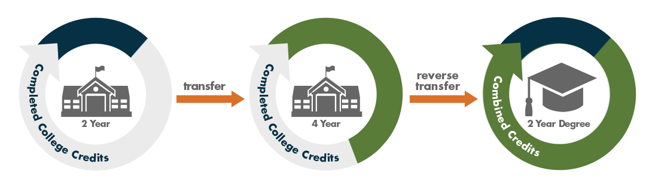
What is Reverse Transfer?
It is the transfer of credits from a four-year (or two-year) institution to any two-year institution from which a student transferred. If eligible, the student is awarded an associate degree.

Slide 34
Benefits of NSC’s Service
Trusted central location for storing and receiving data
Crosses public, private and state lines
Free and unlimited course and grade data exchanges with multiple partners.
The ability for hosts to send all reverse transfer data, for all degree granting institutions, in one file submission
The ability for degree granting Institutions to download their data from all hosts (sending institution) in one location
Increased data quality for everyone because of automatic data validation.
Current student contact information to ensure diplomas are sent to the right address.

Slide 35
StudentTracker Premium Services
Notes:
Let me show you the student experience. Requesters can come into your ordering form from one of three entry points: our public webpage (shown here), a link on your public webpage, and, if you have chosen to use the Clearinghouse’s Student Self Service, they can enter from that page.

Slide 36
StudentTracker New Functionality
Premium Services
  Providing analysis ready reports
    Displays one row per student
    Tracks 8 years of data and calculates cumulative data with highest credential
  Creation of reports library so institutions can store and rerun file. Tracks same cohort of students.
  Leveraging Signature and Snapshot reports to provide institutional versions of those reports
  Institution-specific graphics of outcome data

Slide 37
Data Dictionary
Post-
July 23, 2016
Multiple Years Streamlined
Faster
Collaborations
ANALYSIS READY
Transforms detail report into one student per row
REQUEST FILE RE-RUN
Saves time through re-running instead of re-loading up to four times over a 365 day period
SIGNATURE AND SNAPSHOT REPORTS
More comprehensive completion report and better retention measurement
DATA VISUALIZATION
More reporting aligned with downloading and submitting
Notes:
In the new STCU Premium Service, you will be able to review your results in an analysis ready file, viewing student data in one linear motion, reflecting enrollment and completion (if applicable). You will also have the ability to rerun previous files with the touch of a button as opposed to submitting your same file multiple time for results. With the file rerun capability you will receive updated reports based on the newest data we have in our database. Two other exciting capabilities within the new Premium service are the institution level signature and snapshot reports, generated specifically for your college or university, as well as data visualization which will reflect institution level outcomes and trends.

Slide 38
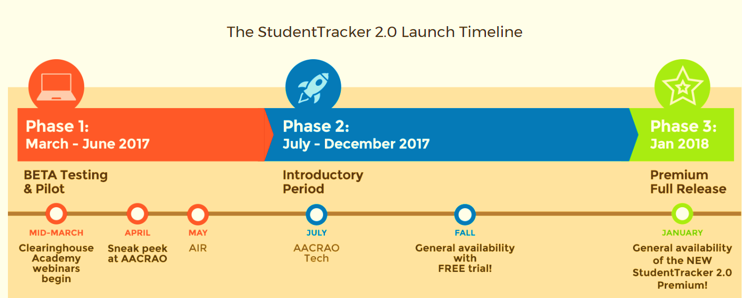
STCU Premium Services Roll-out Plan
https://studentclearinghouse.info/studenttracker/

Slide 39
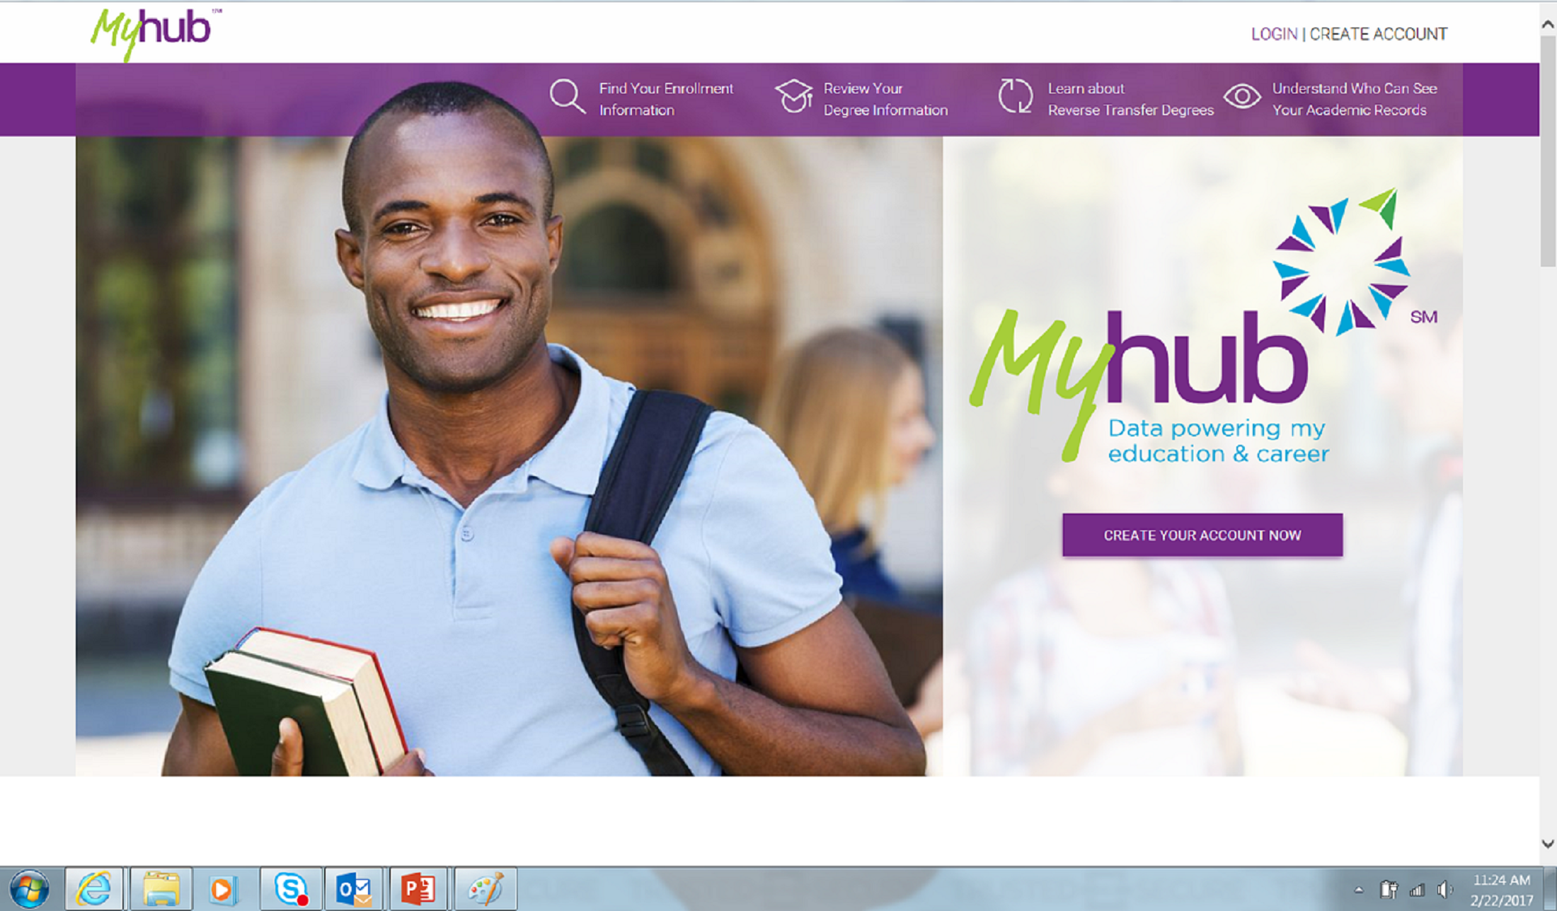

Slide 40
Creation of a Student Academic Portal
Pilot – Later in 2017
For Students to…
  View all their academic data at NSC
  Request corrections when necessary
  Understand how data is used
  Understand purposes of data use
Will meet new coming Federal regulations on data privacy, security and transparency
Notes:
With the Academic Portal, students will be able to access all their information directly through the Clearinghouse.
If a student wishes to dispute information, the Clearinghouse will direct them to the appropriate channels at their institution in order to resolve any discrepancies, as required today by FERPA.
NSC plans to roll out a nationwide data mart to enable enrollment records to be cross-checked against the student’s academic records to ensure greater data accuracy.

Slide 41
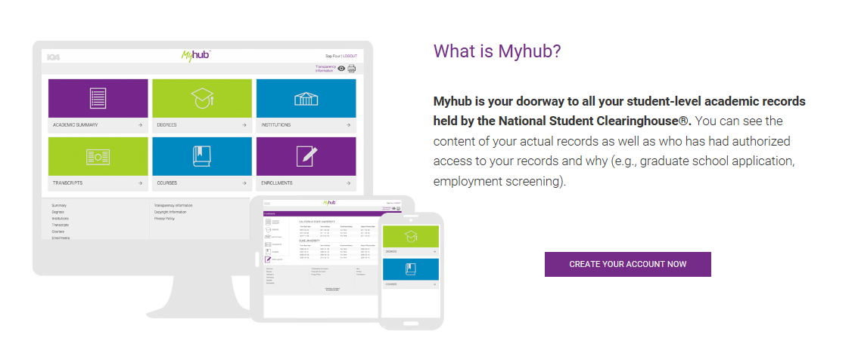

Slide 42
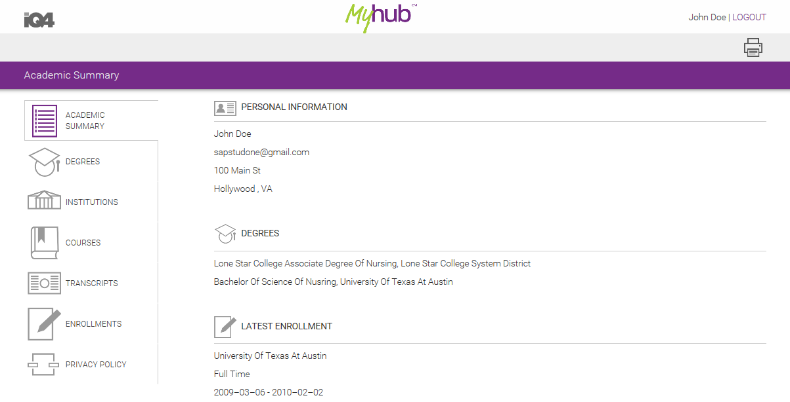

Slide 43
Other Initiatives and our Research Center

Slide 44
NSC is built on a “many to one to many” business model
Data Re-use
COMPLIANCE
VERIFICATIONS
DATA PROVIDERS
RELEVANT DATA REQUESTORS
ACCOUNTABILITY
RESEARCH
STUDENT SUPPORT
School Data
Wage Data
Private 3rd Party Data
DATA EXCHANGE

Slide 45
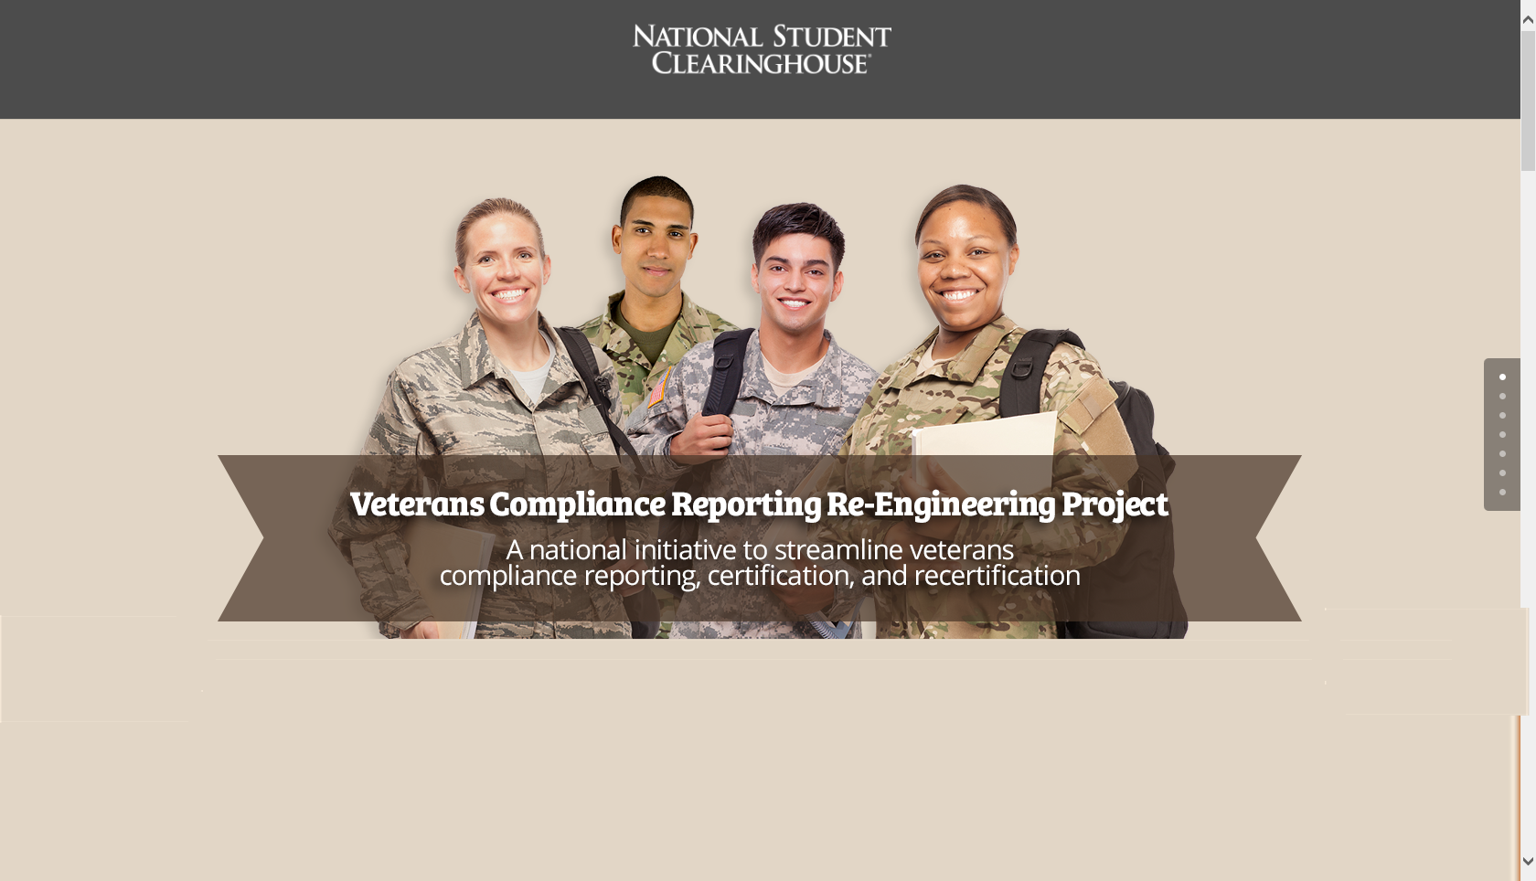
Converts today’s veterans compliance reporting process into a streamlined solution.

Slide 46
Veteran’s Compliance Re-Engineering Project
SVA collaboration on reporting and process improvements needed
Working with VA on ways to automate current processes
Schools supporting initiatives important to moving forward
Blog link: www.studentclearinghouse.info/studentvets/

Slide 47
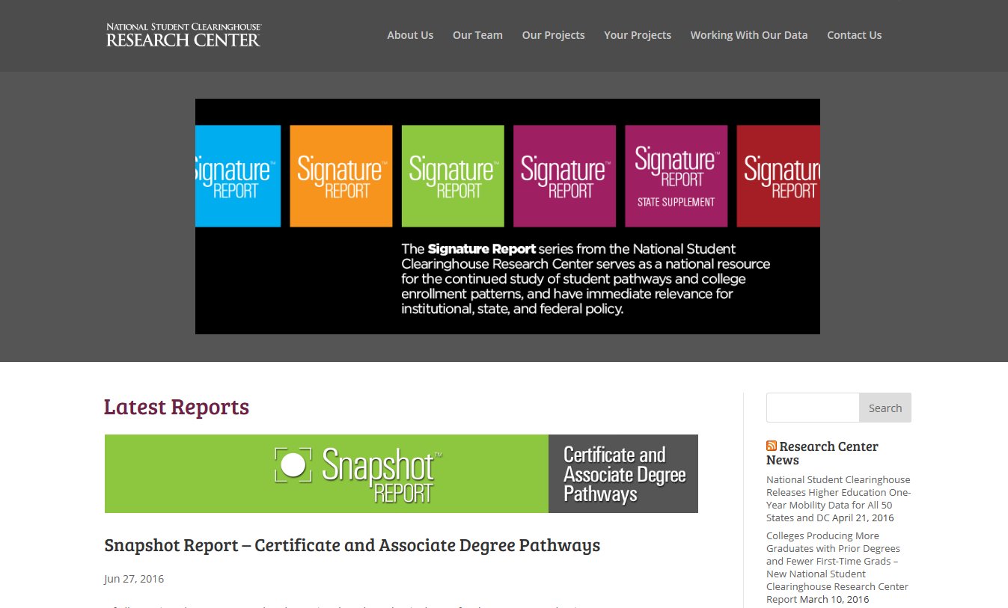
Research Center

Slide 48
Current Term Enrollment Estimates
Spring 2017
Spring postsecondary overall enrollments fell by more than 272,000 students compared to a year ago, led by a decline of more than 244,000 students over the age of 24 and many were enrolled in a four-year, for-profit institution or a two-year public college.
Additional data compared to Spring 2016:
111,000 fewer students (10.1 percent) enrolled in four-year, for-profit institutions, with men experiencing the largest declines in this sector.
138,000 fewer students (2.5 percent) enrolled in two-year public colleges;
7,300 fewer students (0.2 percent) enrolled in four-year private non-profit institutions, with smaller institutions (those enrolling less than 10,000 students) falling by 19,300. Larger institutions only partly compensated, increasing by 12,000;
Graduate/professional students increased by 27,000 (1.1 percent);
Total undergraduate students decreased by 300,000 (1.9 percent);
Engineering majors at four-year institutions increased 3.1 percent.

Slide 49
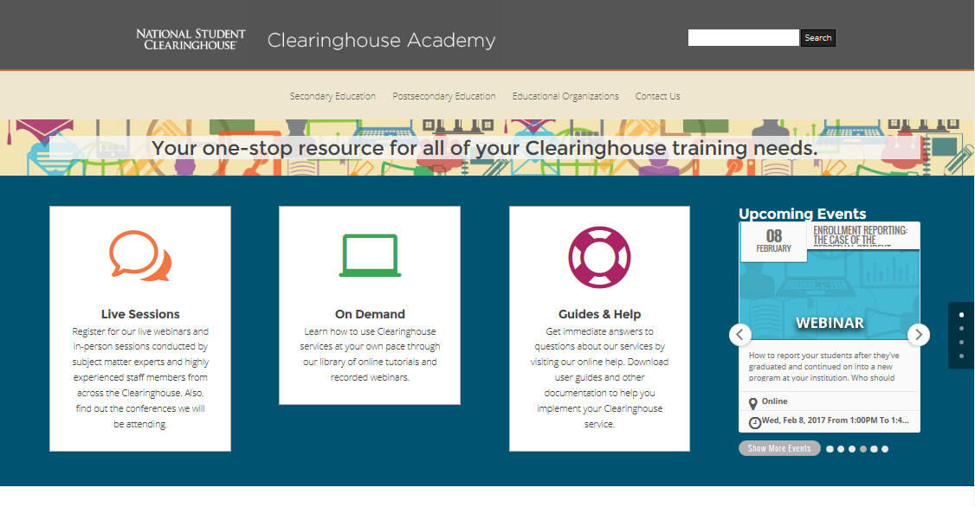
Clearinghouse Academy

Slide 50
Re-Discover the Clearinghouse Academy
Rediscover a new way to get the training and information you need to maximize use of NSC services and increase efficiency. Visit ClearinghouseAcademy.org to access…
Live Webinars
On-Demand Tutorials and Recorded Webinars
Conferences We’re Attending
User Guides and Other Resources
Events Calendar
NSC News and Blog Articles

Slide 51
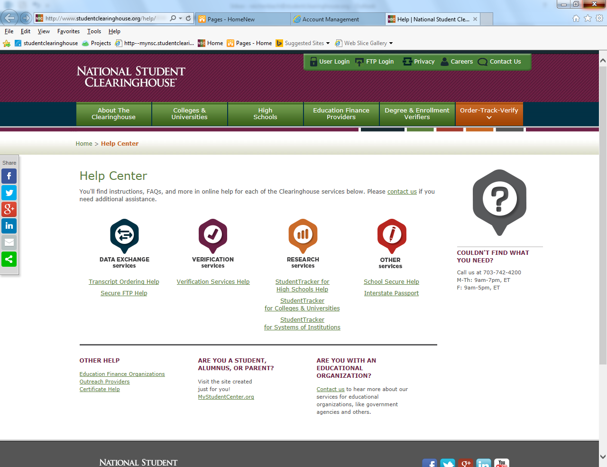
Online FAQs and Help Center

Slide 52
Customer Service Levels & Overview
Call Center
Client Management Team
Clearinghouse
Academy
Online FAQs and Help Center
IM Support
(2017)
Notes:
At a high level, we have our Call Center, the Client Management Team, the Clearinghouse Academy site, the School Secure site on line HELP and FAQ’s, and future IM Support capabilities.

Slide 53





Join Us on Social Media!
Follow or "like" us to keep up to the minute on breaking news, service enhancements, upcoming events, tips/reminders,
new studies from our Research Center, and more.

