Slide 1
SPEEDE 101
Jeffrey B. Lemaster University of Texas at San Antonio
Jesus ‘Jesse’ Salais University of Texas at San Antonio

Slide 2
Agenda
What is SPEEDE
Getting Started
Process Workflow
EDI Layout
Best Practices
Future Exploration
Questions?

Slide 3
What is SPEEDE?
Standardization of Postsecondary Education Electronic Data Exchange.
ANSI ASC X12 Transaction Set TS130
  Format for EDI exchange of transcripts.
  Coded and delimited to allow unambiguous interpretation by a recipient’s computer.
AACRAO Committee
THECB rules (by Sept 2000)
Movement by colleges to automate handling of applications, transcripts, and test scores.
TREx Transcripts

Slide 4
Getting Started
Requirements
Register with SPEEDE
Recommended Implementation Practices for SPEEDE (RIPS)
SPEEDE FAQs
Quick ‘n’ Easy (QNE) Utility

Slide 5
Requirements
Ability to produce EDI documents consistent with ANSI ASC X12 standards
FTP or Internet email with MIME
PGP execute capability (if you plan to encrypt your files)
Email to receive inquiries and notifications

Slide 6
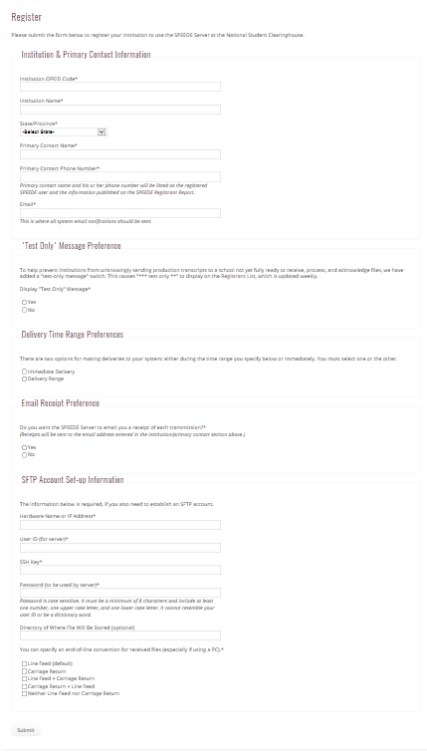
Register with SPEEDE
https://speedeserver.org/register/

Slide 7
RIPS
Recommended Implementation Practices for SPEEDE
http://www.pesc.org/pesc-approved-standards.html
  Introduction and Acknowledgments
  Data to Include in SPEEDE Transcripts
  Conventions for Representing Data
  Other Conventions
  Appendices

Slide 8
SPEEDE FAQs
Can we receive files as soon as they are transmitted to the server?
Are there naming conventions for files dropped off on the server?
What is the naming convention for files delivered from the server via FTP?
Can the server deliver files to a GDG (Generation Data Group)?
Can the server deliver SPEEDE and ExPRESS files separately?
Can we change our registration information?
Will we be notified when data is delivered to our institution?
What IP address needs to be whitelisted to receive files from the SPEEDE Server?
How can I separate test files from production files?
How do I get the PGP software?
What about SSH?

Slide 9
Quick ‘n’ Easy (QNE) Utility
The new Quick ‘n’ Easy (QNE) software is a free Java-based program that replaces the DOS platform and allows a user to print and acknowledge both college and high school transcripts.
Requirement
  Any OS using the latest version of Java Runtime/JDK.
Installation
  Download and unzip the software files into a new directory.
  Launch QNE by clicking the executable file, “QuickAndEasy-2-3-2.exe” (2-3-2 is the software version number), in the new directory.

Slide 10
Process workflow
ABCC prepares ANSI ASC X12 compliant files with proper ISA envelopes
  Send file to National Student Clearing House
XYZU receives file from National Student Clearing House
  By email or FTP
Pass file through Acknowledgement, Translation, and Processing routine
  QNE
  EDI Smart
  Home Grown scripts

Slide 11
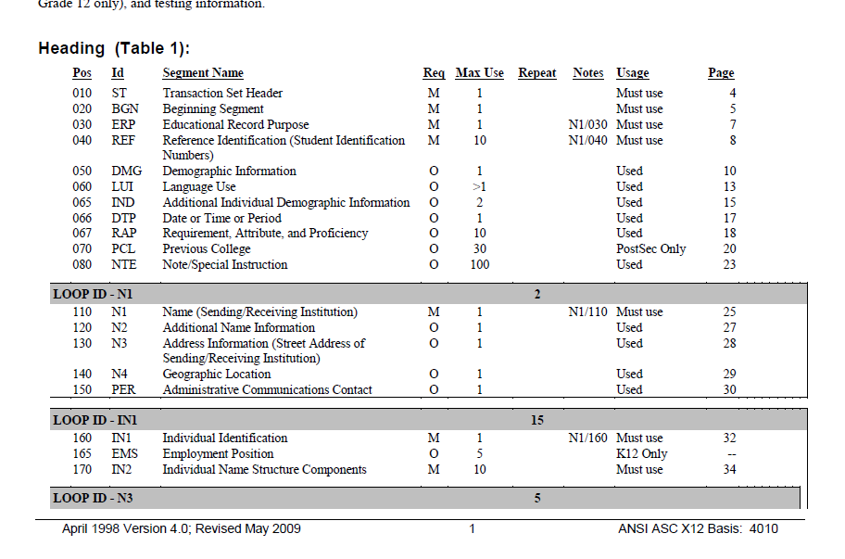
EDI layout
Guide to the Implementation of Transaction Set 130 – Student Educational Record (Transcript) – 123 page document

Slide 12
ISA!00! !00! !ZZ!TXAPP !ZZ!010115 !160721!2018!U!00402!160721001!0!T!$\
GS!AF!TXAPP!UTSA!20160721!0914!160721001!X!004020ED0020\
ST!189!820330001\
BGN!00!820330001!20160721!0914!CT\
N1!TM!!ZZ!TXAPP\
N1!AT!!73!010115\
REF!48!1600859848!FFRESHMAN APPLICATION ID\
DTP!196!CM!201709\
REF!SY!!STUDENT DECLINED TO PROVIDE SSN OR ITIN\
IN1!1!02!!!!18\
IN2!05!QUE\
IN2!02!SUSIE\
IN2!03!P\
REF!PSM!!Y\
DMG!D8!19990404!F!!!1!!8\
IND!!TX!!AUSTIN\
NTE!!Ethnicity=W;Race=S\
N3!7104 WATERLINE RD\
N4!AUSTIN!TX!787312023!!P\
N3!LOCAL SAME AS PERMANENT\
COM!TE! 2104164150 CP\
COM!EM!susieq@yahoo.com\
IN1!1!04!!!!51\
IN2!01!MS\
IN2!02!SUSIE\
IN2!05!QUE\
N3!7104 WATERLINE RD\
N4!AUSTIN!TX!78731\
COM!AP! 2104150613\
COM!EM!motherofsusie@yahoo.com\

Slide 13
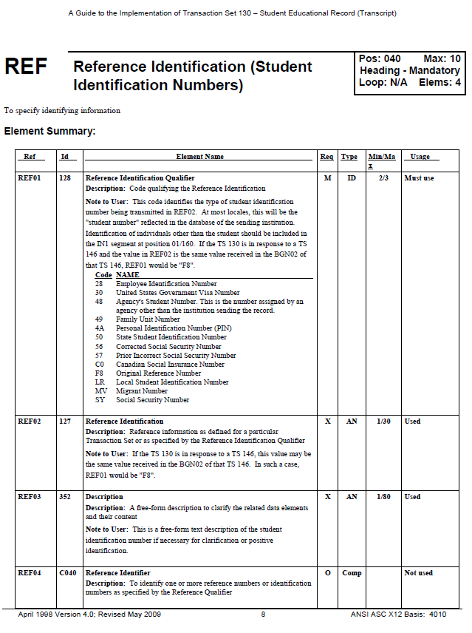

Slide 14
Best Practices
TEST! TEST! TEST!
  Internally
  Transcript Partner School
Follow Published Data Standards
Announce Go Live!
3rd Party Sending/Receiving Solutions

Slide 15
Future Exploration
Electronic Print Outs
Import Courses
Articulate Courses

Slide 16
Questions?
https://speedeserver.org/
http://www.aacrao.org/about/committees/aacrao-speede-committee
http://www.tacrao.org/
http://www.pesc.org/pesc-approved-standards.html
http://tea.texas.gov/index4.aspx?id=25769817556
https://www.applytexas.org/adappc/gen/c_start.WBX
http://www.studentclearinghouse.org/
https://ecommunities.ellucian.com/welcome

