Slide 1

General Reporting Updates
Texas Higher Education
Coordinating Board
TACRAO – University Issues
July 17, 2018

Slide 2
Bachelor of Science Nursing
Third Year BA - Third Year Bachelors
Fourth Year BA - Fourth Year Bachelors

Slide 3
Reporting Related SB 1782
SB 1782 - Allows students who have accrued at least 50 SCH and stopped-out for 24 months one-time exemptions from the six-drop and three-peat rules, and a 15 SCH exemption from the 30-/45-hour rule.

Slide 4
Reporting Related SB 1782
An SB 1782 qualifying student may drop one additional course for a total of 7.
If a student once again drops out for a 24 month period, the student is not granted an additional drop.

Slide 5
Reporting Related SB 1782
For any courses taken twice or more, prior to the first 24 month stop-out, a student may take a course a third time and can be reported for funding

Slide 6
Reporting Related SB 1782
Example One
A student has taken a course one time. After a 24 month stop-out period, the student returns. The student is allowed to take the course an additional time for funding, but may not be reported for a third funding.

Slide 7
Reporting Related SB 1782
Example Two
A student has taken a course twice. After a 24 month stop-out period, the student returns to an institution. The student is allowed to take the course one additional time and be reported for state funding.

Slide 8
Reporting Related SB 1782
Example Three
A student has taken a course three times. After a 24 month stop-out period, the student returns to an institution. The student is allowed to take the course one additional time and be reported for state funding.

Slide 9
Assist with CBM001 and CBM004 Mismatches
When the Census Date CBM001 and CMB002 are open for report submission, the CBM00S will also be opened for submission.

Slide 10
Proposed Assistance with CBM001 and CBM004 Mismatches?
S
SQL
Server
MoveIt
Output
Folder
CBM001
CTC
Edit
Process
CBM001
Univ.
CBM004
CTC
CBM004
Univ.

Slide 11
Proposed Assistance with CBM001 and CBM004 Mismatches?
I know which courses are taught,
and number of students in each, but which students?
I know which students
Are enrolled, but not which courses
CBM001
CBM004
CBM00S
The CBM00S ties the student to the courses and reports may be generated to compare hours and the number of students in each course.

Slide 12
Contact Information
Victor Reyna
Interim Director
Education Data Center
Texas Higher Education Coordinating Board
Victor.Reyna@thecb.state.tx.us

Slide 13
TSI/DE Reporting Updates

Slide 14
CBM002: Revised Item #10 – Program Indicator
0 No or not applicable
2 Student is a current dual credit student
8 Student is in an AEL (Adult Education and Literacy) program
9 Student is enrolled in a Level 2 Cert or Applied Associates degree program that does not require a freshman-level academic mathematics course, and the student is not taking a college-level math course. This does not include students who have undeclared or undecided majors.

Slide 15
Clarifications for Item #10
AEL – Adult Education and Literacy
  Adult Education program administered through TWC, whereby the institution is the fiscal agent and/or a provider. Examples include Accelerate Texas, high school equivalency, Integrated Education and Training, etc.
  New indicator (nothing in prior 002 that equates to AEL)
  Students only in an AEL program may not be reported on the 001 and 002
    No need to create a 002 record if not required

Slide 16
CBM002: Revised Items #21A/#41A/#61A - TSI obligation waived or satisfied through exemption
New or revised options (all other options remain the same)
0 Previously reported
7 Waiver based on Level-One Certificate Program or non-degree-seeking or non-certificate-seeking status
D Waiver for active military duty
E Exemption because of past military experience based on TSI rules
F Exemption based on earned degree from accredited higher education institution
G Dual credit student taking a course other than math/reading/writing. No waiver/exemption applicable
H Waiver for ESL/ESOL developmental education

Slide 17
Reporting Dual Credit Students
Includes
  Item #10 Program Indicator
    Option 2 (Student is a current dual credit student)
  Item #21A/41A/61A TSI Obligation Waiver/Exempted
    Option 6 - Waiver to take math/reading/writing-related dual credit
    Option G – Dual credit student taking a course other than math/reading/writing. No waiver/exemption applicable

Slide 18
Example: Dual Credit Students
A dual credit student is eligible for and enrolled in a Psychology college course (reading and writing intensive). They have a waiver to take math dual credit, but are not enrolled in a math college course.
21A - ‘6’ – waiver to take math-related DC
41A - ‘6’ – waiver to take reading-related DC
61A – ‘6’ –waiver to take writing-related DC
A dual credit student is eligible for and enrolled in a Psychology college course (reading and writing intensive). They only have a waiver to take dual credit reading/writing.
21A – ‘G’ – DC student taking course other than math. No waiver/exemption applicable
41A - ‘6’ – waiver to take reading-related DC
61A – ‘6’ –waiver to take writing-related DC

Slide 19
CBM002 Edit Report Clarification
Prior to Spring 2018, Item 10 on the CBM002 was
Item #10 TSI Obligation Waived or Blanket Exemption
with the following:
NOTE: Waiver information is also reported in items #21A, #41A, and #61A by TSI subject area.
With options “0” – “7”

Slide 20
CBM002 Edit Report Clarification
Beginning Spring 2018, Item 10 on the CBM002 is
Item #10 Program Indicator
With options
0 No or not applicable
2 Student is a current dual credit student
8 Student is enrolled in an Adult Education and Literacy (AEL) program
9 Student is enrolled in a Level 2 Cert or Applied Associates degree that does not require a freshman-level academic mathematic course and the student is not taking a college-level math course. This does not include students who have undeclared or undecided majors

Slide 21
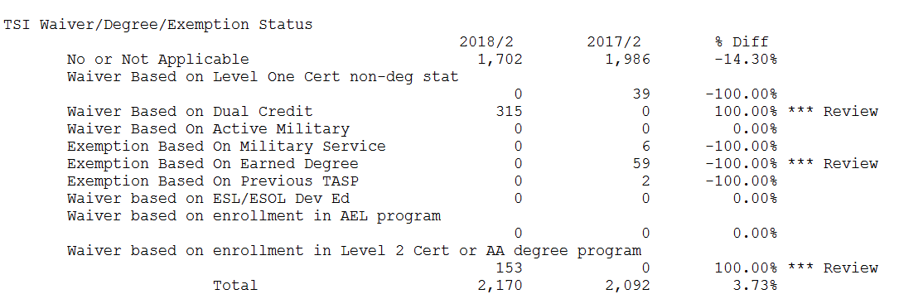
CBM002 Edit Report Clarification
Will be changed to “Program Indicator”
9 – Student is enrolled in a Level 2 Cert or Applied Associates degree ……
8 – Student is enrolled in an Adult Education and Literacy (AEL) program
2 – Student is a current dual credit student
0 – No or not applicable

Slide 22
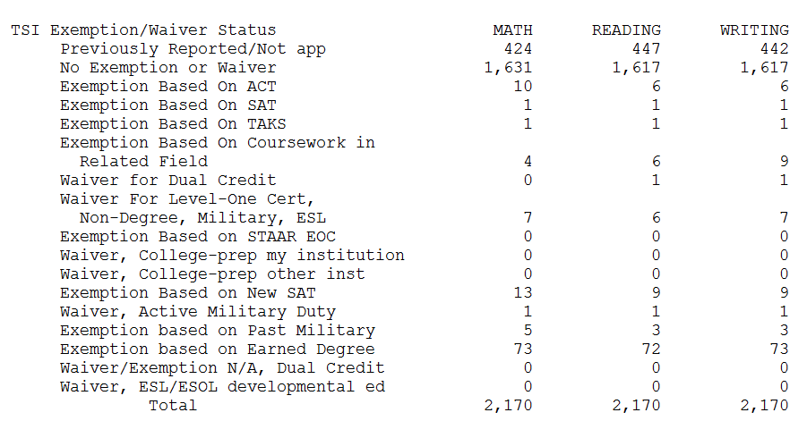
CBM002 Edit Report Clarification
Item 21A 41A 61A

Slide 23
CBM00S: Revised Item #19 (Univ)/#22(CTCs)
Developmental Education Course/Intervention and Corequisite
0 Not a developmental course/intervention or not a paired college course
1 Developmental course – not part of a corequisite model
4 Developmental intervention (NCBO)– not part of a corequisite model
7 Self-paced course or intervention – not part of a corequisite model
8 Corequisite DE course
9 Corequisite DE intervention (NCBO)
A Self-paced course or intervention – part of a corequisite model
B College-level course paired with DE

Slide 24
CBM00S: Edit Check for DE and HS Students
Reporting for HS Credit Status Item is subject to an edit check against DE Course/Intervention Item
Courses reported for Dual Credit can only be non-DE courses
High School Credit Status - #18 (Univ)/#21 (CTCs)
0 Not a HS Student
1 Student is not yet HS graduate, course reported is for dual credit
2 Student is not yet HS graduate, course reported is for college course only
DE Course/Intervention - #19 (Univ) / #22(CTCs)
0 Not a DE course/intervention or not a paired college course
1 DE course – not part of a corequisite model
4 DE intervention (NCBO)– not part of a coreq
7 Self-paced course or intervention – not part of a coreq
8 Corequisite DE course
9 Corequisite DE intervention (NCBO)
A Self-paced course or intervention – part of a corequisite model
B College-level course paired with DE

Slide 25
Proposal for Reporting Unfunded DE hours
Need accurate report of DE hours for research and HB 2223 reports
Unfunded DE should not be reported as ‘0’ hours on CBM reports
Report appropriate hours in ‘unfunded DE’ items

Slide 26
Proposal for Reporting Unfunded DE hours
No substantive changes to CBM Items, only language revisions for clarity
CBM001
  Contact Hours – DE NOT State Funded. (#30 CTC)
  SCH - DE NOT State-Funded. (#23 CTC, #22 Public Univ)
CBM004
  Enrollment of Students Whose Developmental SCH is NOT State-Funded (#6B CTC, #17 Public Univ.)
CBM00S
  SCH NOT State-Funded. (#12 CTC and Public Univ)
  Contact Hours Not State-Funded. (#15 CTC)
  SCH NOT Funded Reason. (#20 CTC, #17 Public Univ)
CBM0E1
  SCH – DE NOT State-Funded. (#23 CTC, #22 Public Univ)
  Contact Hours – DE NOT State-Funded. (#30 CTC)

Slide 27
Contact Information for DE/TSI Reporting
Melissa Humphries
Senior Research Specialist
Research and Evaluation, Strategic Planning and Funding
Melissa.Humphries @thecb.state.tx.us
Bobby Jenkins
Program Director
Research and Evaluation, Strategic Planning and Funding
BR.Jenkins@thecb.state.tx.us

