Slide 1

Update from Strategic Planning and Funding
Texas Higher Education
Coordinating Board
Strategic Planning & Funding staff
TACRAO
July 17-19, 2018

Slide 2
Updates & Priorities for FY2019
5-year data review
Timely submission of data
Transfer
Accelerating student completion via 8-week courses
Update on 60x30TX

Slide 3
Negotiated Rulemaking Committee (NRMC): Data Request Reevaluation
Texas Education Code 51.406 directs THECB to:
reevaluate its rules and policies to ensure the need for data it requests from IHEs and
consult with IHEs to identify any unnecessary data requests for removal from Board rules
NRMC formed to consult with THECB on tasks:
THECB staff compiled list of 93 data requests and reports routinely required of all IHEs or IHEs in a sector
Staff proposed a second list that identified 14 of the 93 for NRMC discussion and possible modification or deletion

Slide 4
NRMC/THECB Review Process
NRMC convened at THECB 12/5/2017 to make recommendations on proposed THECB and any other data requests or reports its members proposed:
28 total data requests and reports proposed for modification or deletion
Afterwards, THECB status of NRMC recommendations includes:
7 requiring potential statutory change
4 Board rule changes
7 require determining feasibility of process changes
4 result in CBM manual changes
5 receiving work group study

Slide 5
NRMC Data Request Reevaluation:
Summary
HB 400 School Districts
Affordability and Access
HB 400 report for TEA
Similar to the THECB HB 2550 high school report
HB 2550 report can serve both purposes
Review/modify TEC 29.904 (amended by HB 2223, 85th R.S.) and/or TEC 51.810, 83rd
Required of IHEs for preceding fall, spring, summer semesters – too frequent
IHEs report narrative data on online form
THECB populates numerical data
Review/modify TEC 51.4031

Slide 6
Sample NRMC Recommendations Requiring Statutory Changes (cont.)
State-funded Campus-based Programs
Community College Transfer Student Requirement
Eliminate duplicative items about excess funds on FADS
Determine data still needed to meet public demand
Review/modify TEC 54.5021
Eliminate annual GAI survey reporting
Delete 60 SCH transfer definition
THECB continues writing annual report based on CBM data
Review/modify SB 1, 85th, Sec. 49, 888-269 [Note. Rider No. changes biennually]

Slide 7
Negotiated Rulemaking Committee manual changes, Simple Deletions:
CBM008 Faculty Report – Delete New Hire Item 19 for Universities, Item 12 for CTCs and Item 16 for health related institutions (HRIs)
CBM00B Admissions Report – Delete Items 15, 16 and 20 related to parental education and family obligations
CBM001 Student Report – Delete Item 22E Programs to Eliminate Gender Bias affecting the CTCs
CBM00A Continuing Education Student Report – Delete Item 22E Programs to Eliminate Gender Bias affecting the CTCs
Manual Deletions will be scheduled for fall 2018
Notes:
WHAT IS THE TIMING OF THESE CHANGES (AS DETERMINED BY SPRING WEBINAR?)

Slide 8
Negotiated Rulemaking Committee manual changes, Combine Items:
CBM001 Student Report – Delete Item 10B SCH Load, Off-Campus affecting the Universities (and combine the off-campus and on campus hours in Item 10A)
CBM001 Student Report – Delete Item 11 SCH Remote Site for the HRIs (and combine the off-campus and on campus hours in Item 10)
Manual Update for Combined Items will be scheduled for Fall 2019
Notes:
WHAT IS THE TIMING OF THESE CHANGES (AS DETERMINED BY SPRING WEBINAR?)

Slide 9
Proposal for timely submission of data
Internal THECB working group delved in to the underlying drivers of late submission and surfaced possible strategies for improvement
2+ year effort designed to achieve:
100% of fall CBM reports collected by EDC are certified by the institutions as available for use within SIX working weeks of the due date. (appx Dec 1)

Slide 10
Suggested strategies for timely submission of data
Revise certification notification process in manuals
  Shift from focus on due date to focus on certification date
  Move from four weeks to six weeks for certification post due-date
  Standardize and automate process of notifications, for example….
    Call to operational contact
    Email to reporting official
    Email to president
Increase transparency around timeliness of data submission and audit risk

Slide 11
Suggested strategies
Improve edit check reports to provide more guidance on issues
Develop a best practices resource
  Strategies for the timing and process of changing student information systems
  Troubleshooting common errors
Develop tools to enhance accuracy of reporting
  Open the 00S earlier
Honor those who meet deadlines

Slide 12
Your input…
These ideas are nascent
Do you have suggestions for how best to operationalize these ideas?
Are there other strategies you’d like to suggest?
Is there a role TACRAO might play?

Slide 13
Field of Study completions are low, although growing modestly

Slide 14
21 colleges awarded a field of study in the last 4 years
Field of Study Awards Who Also Received CCC or Assoc
FOS = Unduplicated number of FOS awards CCC = FOS plus Core Complete ASSOC = FOS plus Assoc degree
distfice | instname | FOS14 | CCC14 | Assoc14 |  | FOS15 | CCC 15 | Assoc15 |  | FOS16 | CCC16 | Assoc16 |  | FOS17 | CCC17 | Assoc17
003539 | ALVIN COMMUNITY COLLEGE | 56 | 14 | 53 |  | 70 | 2 | 70 |  | 91 | 20 | 89 |  | 28 | 11 | 28
003540 | AMARILLO COLLEGE | 216 | 92 | 141 |  | 161 | 59 | 98 |  | 216 | 41 | 134 |  | 228 | 97 | 161
003549 | BLINN COLLEGE DISTRICT | 8 | 0 | 0 |  | 0 | 0 | 0 |  | 0 | 0 | 0 |  | 10 | 0 | 0
003563 | DEL MAR COLLEGE | 111 | 50 | 90 |  | 64 | 38 | 50 |  | 77 | 16 | 67 |  | 44 | 22 | 40
003570 | GRAYSON COLLEGE | 61 | 5 | 61 |  | 6 | 0 | 6 |  | 14 | 0 | 14 |  | 33 | 32 | 33
003572 | TRINITY VALLEY COMM COLLEGE | 20 | 0 | 3 |  | 16 | 0 | 8 |  | 9 | 0 | 2 |  | 9 | 1 | 3
003573 | HILL COLLEGE | 19 | 12 | 3 |  | 2 | 0 | 0 |  | 1 | 0 | 0 |  | 0 | 0 | 0
003580 | KILGORE COLLEGE | 72 | 14 | 72 |  | 48 | 13 | 48 |  | 75 | 14 | 75 |  | 47 | 10 | 47
003582 | LAREDO COMMUNITY COLLEGE | 9 | 2 | 9 |  | 4 | 0 | 4 |  | 1 | 0 | 1 |  | 4 | 1 | 4
003583 | LEE COLLEGE | 0 | 0 | 0 |  | 6 | 3 | 6 |  | 6 | 5 | 4 |  | 17 | 6 | 14
003590 | MCLENNAN COMMUNITY COLLEGE | 96 | 34 | 43 |  | 129 | 42 | 60 |  | 116 | 30 | 52 |  | 117 | 43 | 65
003600 | PANOLA COLLEGE | 18 | 3 | 9 |  | 8 | 1 | 3 |  | 6 | 1 | 4 |  | 9 | 2 | 6
003626 | TARRANT COUNTY COLLEGE DIST | 84 | 35 | 38 |  | 126 | 46 | 59 |  | 104 | 39 | 42 |  | 221 | 77 | 99
003648 | TYLER JUNIOR COLLEGE | 192 | 137 | 7 |  | 195 | 130 | 9 |  | 188 | 129 | 7 |  | 186 | 111 | 7
009331 | DALLAS CO COMMUNITY COLL DIST | 192 | 120 | 192 |  | 243 | 177 | 241 |  | 264 | 176 | 262 |  | 341 | 245 | 340
010387 | EL PASO COMMUNITY COLLEGE DIST | 381 | 233 | 373 |  | 411 | 202 | 409 |  | 434 | 313 | 434 |  | 642 | 497 | 642
011145 | LONE STAR COLLEGE SYSTEM DIST. | 223 | 1 | 10 |  | 277 | 30 | 2 |  | 436 | 25 | 26 |  | 309 | 213 | 210
012015 | AUSTIN COMMUNITY COLLEGE | 340 | 29 | 57 |  | 454 | 49 | 103 |  | 212 | 63 | 108 |  | 194 | 41 | 96
023614 | COLLIN CO COMM COLL DISTRICT | 169 | 85 | 119 |  | 227 | 129 | 166 |  | 267 | 158 | 195 |  | 270 | 181 | 244
029137 | SAN JACINTO COMMUNITY COLLEGE | 68 | 36 | 62 |  | 88 | 41 | 78 |  | 95 | 62 | 87 |  | 116 | 54 | 105
031034 | SOUTH TEXAS COLLEGE | 572 | 72 | 553 |  | 863 | 114 | 837 |  | 836 | 123 | 800 |  | 1,024 | 549 | 996
445566 | STATEWIDE | 2,907 | 974 | 1,895 |  | 3,398 | 1,076 | 2,257 |  | 3,448 | 1,215 | 2,403 |  | 3,849 | 2,193 | 3,140
Source: CBM009

Slide 15
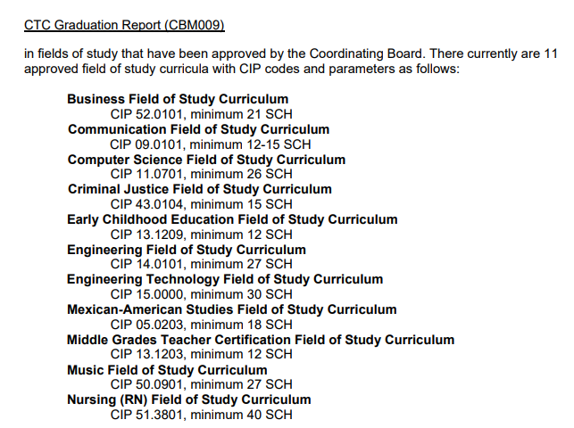

Slide 16
8-week course reporting
8-week courses are associated with improved student success
Odessa College has implemented this model at scale
Now, we would like to support scaling by other institutions by modifying reporting and formula funding runs to better include 8-week courses

Slide 17
Proposal to Legislative Budget Board (LBB) for 8-week course reporting
2nd 8 week courses must be certified by deadline of 6 weeks after initial published reporting due date
Proposed modifications to formula runs
  Preliminary Base-Year Run
    Previous Spring - Certified
    Summer 1 - Certified
    Summer 2 - Certified
    Current Fall 1 – Error Free
    Previous Fall 2 – Certified
  Final Base-Year Run
    Previous Summer 1 - Certified
    Previous Summer 2 - Certified
    Fall – Certified
    Spring 1 – Error Free
    Previous Spring 2 – Certified

Slide 18




Overview of 60x30TX Plan
Vision for the 60x30TX Higher Education Strategic Plan
Higher education is attainable for Texans of all backgrounds through challenging and diverse learning
environments that foster individual potential and maximize the societal and economic contributions of graduates.
GOAL ONE: 60x30: EDUCATED POPULATION
GOAL TWO:
GOAL THREE:
GOAL FOUR:
COMPLETION
MARKETABLE SKILLS
STUDENT DEBT

Slide 19
Texas had good progress this year, particularly in 60x30 and overall completions.
Goal | Target | 2016* | 2017* | 2030 Goal/Target
60x30 | 60x30 (Attainment) | 41.0% | 42.3% | 60%
Completion | Overall | 321,410 | 333,920 | 550,000
 | Hispanic | 103,889 | 111,344 | 285,000
 | African American | 38,813 | 41,027 | 76,000
 | Male | 135,849 | 141,564 | 275,000
 | Economically Disadvantaged | 119,490 | 124,178 | 246,000
 | TX High School Graduates Enrolling in TX Higher Education | 51.9% | 52.3% | 65%
Marketable Skills | Working or Enrolled Within One Year | 78.8% | 78.4% | 80%
Student Debt | Student Loan Debt to First Year Wage Percentage | 60% | 59% | 60%
 | Excess SCH Attempted | 18 | 18 | 3
 | Percent of Undergraduates Completing with Debt | 48.2% | 47.2% | 50%
*Data for each year are most current available.
Notes:
Overall we are doing well on the plan goals and targets
Good news (STATEWIDE):
we estimate we need 1.3 ppt increase in the 60x30 educated population goal each year and we made exactly that much progress this year.
We estimate we need 3.9% increases in completion each year for the overall completion goal, and we made exactly that much progress this year.
Doing well on our maintenance goals related to marketable skills and student debt.

Slide 20
Accelerated progress is needed for some of the targets under the completion goal
Goal | Target | 2016* | 2017* | 2030 Goal/Target
60x30 | 60x30 (Attainment) | 41.0% | 42.3% | 60%
Completion | Overall | 321,410 | 333,920 | 550,000
 | Hispanic | 103,889 | 111,344 | 285,000
 | African American | 38,813 | 41,027 | 76,000
 | Male | 135,849 | 141,564 | 275,000
 | Economically Disadvantaged | 119,490 | 124,178 | 246,000
 | TX High School Graduates Enrolling in TX Higher Education | 51.9% | 52.3% | 65%
Marketable Skills | Working or Enrolled Within One Year | 78.8% | 78.4% | 80%
Student Debt | Student Loan Debt to First Year Wage Percentage | 60% | 59% | 60%
 | Excess SCH Attempted | 18 | 18 | 3
 | Percent of Undergraduates Completing with Debt | 48.2% | 47.2% | 50%
*Data for each year are most current available.
Notes:
Challenges (STATEWIDE)
We estimate we need growth of 5.2% for male completions and we only went up 4.2% this year
We need growth of 5.3% each year for eco dis completions and we only went up 3.9%
Althought the HS to HE target is not yet available for this year due to the timing/availability of TEA data, this target has been declining since 2014.

Slide 21
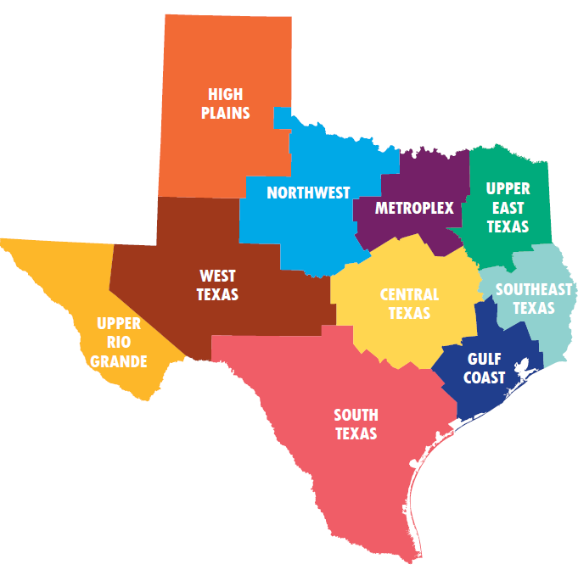
60x30TX regional targets promote regional mobilization and strategy development
Regions and institutions differ in many ways. Institutional actions and outcomes are embedded in regional context.
THECB has identified regional targets in three areas:
60x30 Educated Population Goal
Completion Goal of 550,000 certificates, associate, bachelor’s, and master’s degrees
65% High school-to-higher education direct enrollment
Regions are convening locally to identify “best bet” strategies by August 2018
Notes:
THECB has developed regional targets in 3 areas:
60x30 Educated Population Goal
Completion Goal of 550,000 certificates, associate, bachelor’s, and master’s degrees
65% High school-to-higher education direct enrollment
We have identified these areas to help mobilize regional stakeholders, including K-12, business/industry partners and higher education stakeholders, to develop their “best bet” strategies for achieving the 60x30TX goals and targets by August 2018.
Setting regional targets is a compelling strategy for several reasons. The first is that one size doesn’t fit all. Our 10 higher education regions identified on the map differ by population growth and demographics and are home to different labor markets. Some are net importers of graduates. Others produce more completers than their labor markets can absorb. Some regions produce many certificates, others many master’s degrees. When it comes to the 60x30TX goals, regions are starting in very different places. Institutions within those regions differ dramatically by mission, funding, and student population, just to name a few.
THECB rolled out preliminary regional targets in fall 2017, trained data fellows on regional data and targets, provided technical assistance to institutions, and identified a dedicated staff point of contact for each region.
Regions themselves have now identified local advisory groups and are in the process of holding in-person convenings of K-12, HE, business/industry, and other community leaders to develop their 3 regional strategies. All 10 regions have established advisory groups. 3 regions have held meetings already. 4 more have meetings scheduled for the next month or two (The other 3 are still planning their meetings).

Slide 22
Coordinating Board will work with regions and institutions to roll out targets in AY 2017-2018
Activity | 2017 – 2018 Timeline
Pilot regional target process and support materials | October – December 2017
Data fellows trainings | November 2017, May 2018
Starter kit released | January 2018
THECB-led regional kickoff webinars for other 9 regions | January – February 2018
Regional volunteers, meeting organization, follow-up communication, in-person meetings | March – August 2018
Accountability meetings | March – April 2018
Preliminary regional targets become official regional targets | May 2018
Regional target submission forms (detailing strategies and institutional targets) due | August 2018

Slide 23
Updates & Priorities for FY2019
5-year data review
Timely submission of data
Transfer
Accelerating student completion via 8-week courses
Update on 60x30TX

Slide 24
Thank you!
Texas is recognized as one of the premiere higher education data systems, for example by the State Higher Education Executive Officers
Data Fellows have been impressed by usefulness of data and affiliated analysis
Your data powers the:
  60x30TX.com site,
  Accountability System,
  Almanac, and
  many other resources widely used by legislators and stakeholders across the state

